Slide 1




Grand Bargain Series
Where are the Women? Gender, Localisation and the Grand Bargain

Slide 2
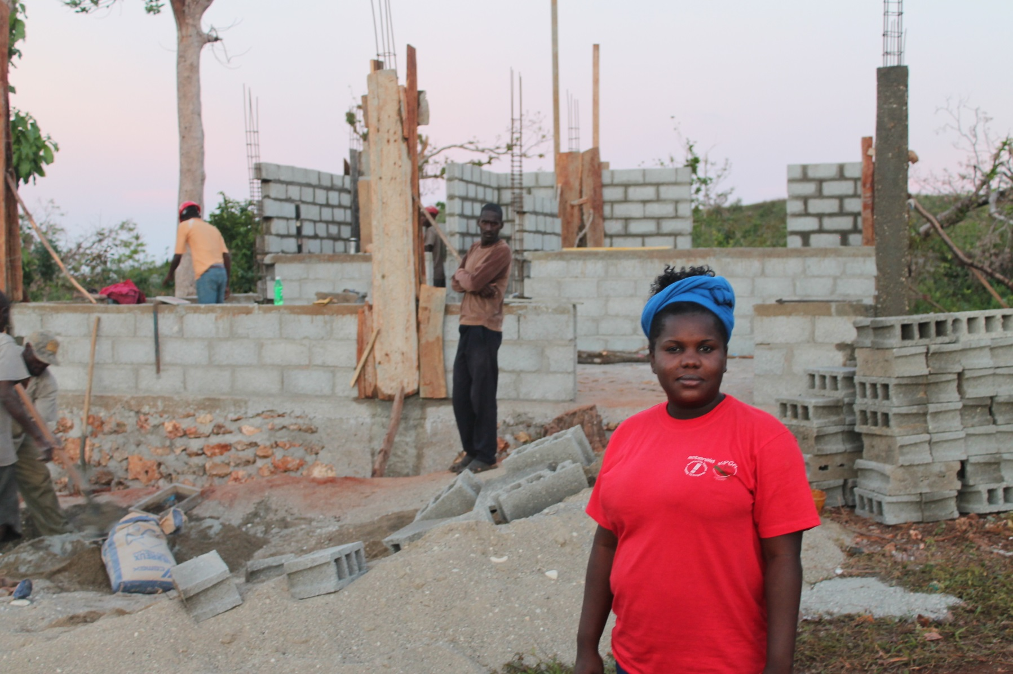
Nadège Pierre

Slide 3
A new transformative humanitarian action
Dublin, 26 September 2017

Slide 4
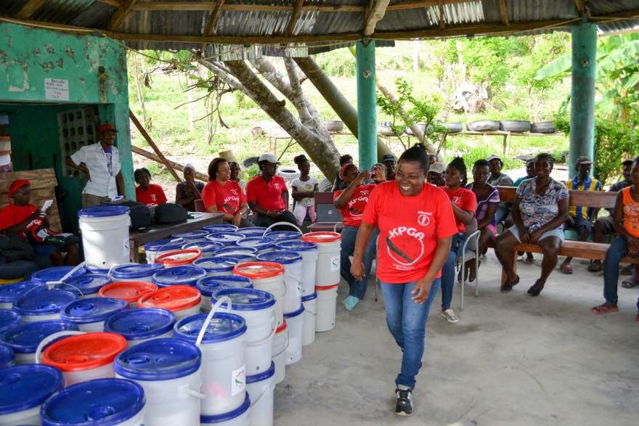
From affected population to a recovery committee that could lead on preparedness and policy work
ActionAid’s Humanitarian Signature

Slide 5
The International Humanitarian System
UN, ICRC, INGO
80% Humanitarian Funding
Local and National NGO
Local and National
Women Organisations

Slide 6
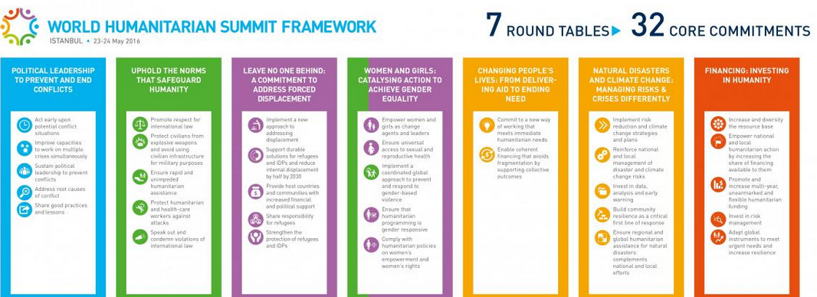
Opportunities for Transformation

Slide 7
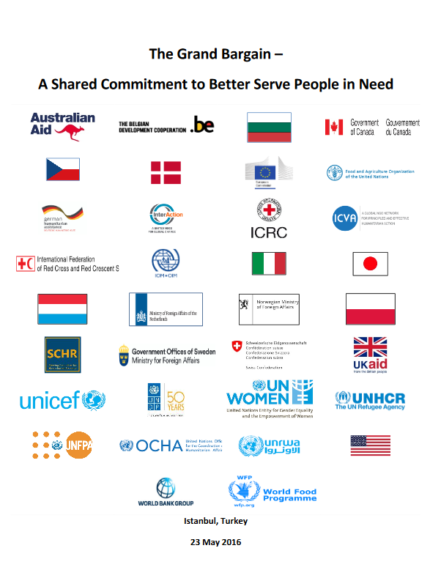
Opportunities for Transformation
“Achieve by 2020 a global, aggregated target of at least 25 per cent of humanitarian funding to local and national responders as directly as possible to improve outcomes for affected people and reduce transactional costs”.

Slide 8
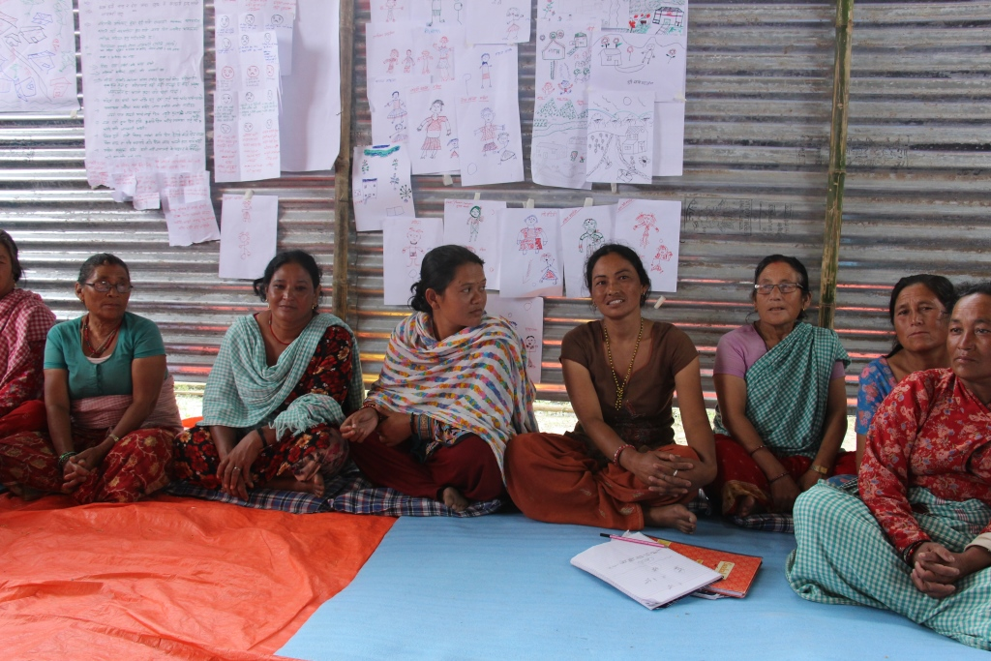
What We All Need To Do

Slide 9
Where are the Women? Gender, Localisation and the Grand Bargain

Slide 10
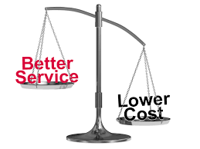
Localisation - Let’s start with what it isn’t
It isn’t a new concept
– local responders are in every country in many forms
– many INGOs work in partnership in specific contexts
It isn’t an ‘either/or’ discussion – it is a necessary debate to make aid more efficient, rapid and effective
It doesn’t mean that largescale responses are not necessary –better, smarter partnerships are needed
#value for money
#as local as possible & as international
as necessary
Notes:
Media……skynews effect

Slide 11
As local as possible & as international as necessary
Tsunami Response Evaluation 2004
Local people provided almost all immediate life-saving action and early emergency support
…….rethink the end goal of humanitarian assistance and move from a service delivery approach to a capacity empowering framework, ………shift the emphasis from only delivery to support and facilitation.
Typhoon Haiyan 2013
…..the challenge of taking partnership to scale, and it is this that sets an important and urgent agenda for the humanitarian community.
International and national coordination mechanisms diverged along separate paths for quite some time
Ebola Sierra Leone 2014/15
National NGOs had to take on the humanitarian response without the safety nets of insurance, evacuation, specialist skillsets, counselling and aftercare, and adequate staff to cope with additional pressures
Notes:
Sierra Leone mudslides – comment here

Slide 12
CHANGING HOW AID HAPPENS
Less than 2% of all humanitarian funding goes directly to local aid organisations. GB aim – increase funding to 25% by 2020
Local first responders; they know the context, speak the language and will be there long after international actors leave. Yet their crucial role is often ignored by the current humanitarian system.
Local organisations also face greater risks: 90% of humanitarian workers who were killed in 2014 were local responders. In 2015, 13 times as many national staff victims as international (expatriate) victims in Somalia & Afghanistan, and 7 times as many globally.

Slide 13

Why ask ‘Where are the Women’?

Slide 14
Why ask ‘where are the women’?
We can’t assume that gender is adequately considered in the Grand Bargain.
The WHS did go some way to recognising women as agents in humanitarian work and not as victims and beneficiaries
Localisation workstream recognises the role of women as first responders & women’s leadership roles & depends in part on successful engagement with and investment in women and women’s organizations as local and first responders, given the reality of women’s leadership in local response.
Agency Voice Control Power
Notes:
Reference: ICVA Grand Bargain Aide Memoire https://www.icvanetwork.org/resources/grand-bargain-aide-memoire-gender-mainstreaming
http://www.actionaid.org/sites/files/actionaid/on_the_frontline_catalysing_womens_leadership_in_humanitarian_action.pdf

Slide 15
Localisation (Trócaire, Groupe URD funded by Irish Aid HPP)
MYANMAR DRC
Examine the experience of Trócaire and partners in selected countries to provide the organisation with a working definition of 'Localisation'.
Collect evidence of how operating in partnership with national organisations is an important element of effective humanitarian response in two different contexts
Recommendations for how greater localisation can be achieved - for Trócaire, partners; peers and in the humanitarian policy arena.

Slide 16
Localisation – What it means for Trócaire
Localisation of aid is a collective process from the various stakeholders of the humanitarian system (donors, UN agencies, NGOs), which gives a more central and important place to local actors - either local authorities or civil society organisations.
The objectives of localisation are multiple and ultimately aim to strengthen the resilience of communities and societies affected by crises by building, in addition to a more effective and efficient humanitarian response, the link with development.

Slide 17
Experiences of partners in humanitarian response
Imbalance of power & lack of trust of LNGOs
Host of challenging practical Issues : IT; electricity; security; financial accountability; unrestricted funding, HR, funding gaps, no overheads or investment in viable organisation structure
Capacity building agendas – for the purposes of international actors only
Partner-centred accompaniment & institutional strengthening is rare*
Security & Access Challenges– infrastructure, context, isolation, RISK
Gender – retaining female staff in high-risk settings/sexism/culture/intimidation
Lack of transparency of INGOS, UN agencies and LNGOS (accounts/budgets/needs assessments & proposal writing)
Two main areas of tension:
Limited sources of direct funding for LNGOs and increased competition for funds
Inequity of expectations & conditions: salaries, overhead costs, support costs, T&Cs
Notes:
* Highlighted as an approach Trócaire uses that is not common to all – accompaniment versus subcontracting

Slide 18
SOPHI PADI - Mme JULIENNE LUSENGE Testimony WHS
“Our organisation was created in 2000 when there was an inter-ethnic conflict in Ituri. While providing assistance to the displaced, we identified victims of sexual violence amongst the displaced women and we began to provide holistic care to the survivors including the judicial aspect.
Resources need to be made available to women’s groups who provide women with legal assistance. Humanitarian organisations should make justice for women a priority at the same time as they conduct humanitarian operations because when there is no support from donors, we contribute ourselves or we use our salaries to pay the fees (…).
Humanitarian action needs to remain human, and not a job; humanitarian action should exist to help human beings. We hope that by the end of this summit, we will have restored the image of Humanitarian action”.

Slide 19
The big 6 issues identified
Heightened tension between national & international actors: funding & competition
Challenges of the sector – treatment of LNGOs/North-South relations/respect & equal treatment
Humanitarian principles
Security management & risk transfer
Direct funding and accountability
LRRD/Hum-Dev Nexus

Slide 20
Research findings
Local actors are invited to clusters/coordination mechanisms but not facilitated to play an active role (language/culture)
Existence of parallel coordination systems (Sector/cluster – led by HCT/led by local government))
Weak local/national government administrations or no interest in humanitarian issues for political reasons (Capacity v Will)
Humanitarian coordination – funding, decision-making, appeals etc remains largely centered around International actors
Capacity-building v institutional strengthening (Once you train, how can you retain?)
Donors are reluctant to fund LNGOs directly for management and risks reasons.
The Country Based Pooled Funds are seen by donors as a way to implement their commitment to fund local organisations ‘as directly as possible’.

Slide 21
Recommendations
for Trócaire (18 recommendations) | for the Sector
Strengthen partnership approaches in humanitarian action: Avoid competing with local partners Avoid cyclical short-term project-based approaches Commit to partnerships beyond the length of a contract Work with partners to develop institutional funding strategies Support partners to strengthen systems and competencies Evaluate capacity support/added value | Increase flexible administrative costs Plan in years, not in months Promote smart, strategic capacity support Be transparent on funding availability and eligibility Acknowledge the cost of engagement to local actors Localise the localisation conversations!

Slide 22
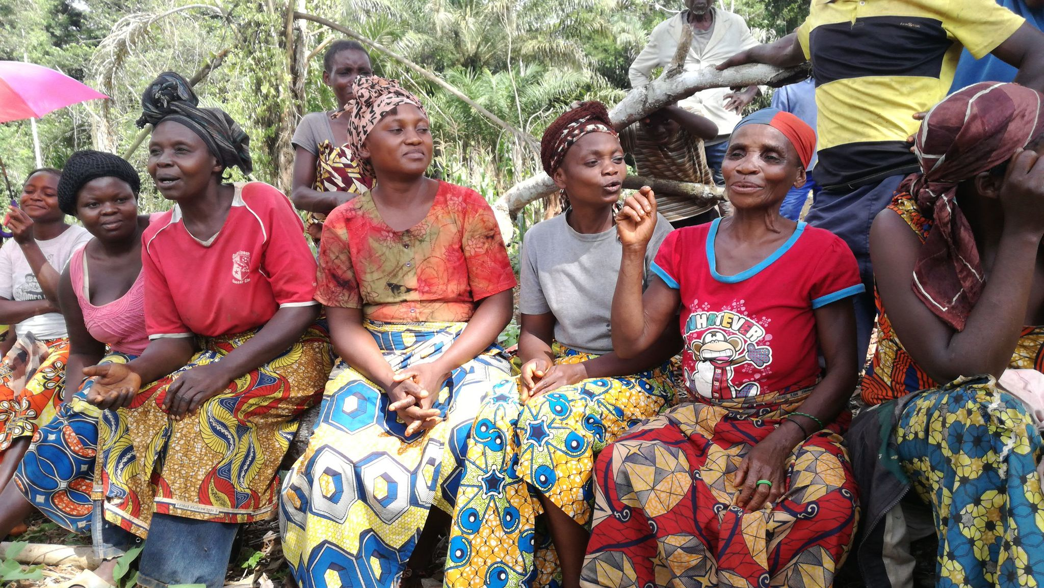
Agency Voice Control Power

Slide 24
Where are the Women? Gender, Localisation and the Grand Bargain
A Donor Perspective

Slide 25
Humanitarian Policy 2015
Principles:
importance of first responders
need for individual and differentiated response
vulnerable groups are agents of change
women and girls affected disproportionately
central role of UN
authority of ICRC
role of NGOs in providing assistance

Slide 26
Policy objective 1
To provide needs based humanitarian assistance
Commit to:
- putting disaster affected people at core of humanitarian response
- equitable attention to needs of vulnerable, esp
of women and girls
- promotion of gender equality and empowerment of women key to this.
-gender /GBV specific focus

Slide 27
Policy objective 2
To demonstrate Ireland’s leadership and partnership for effective international humanitarian action, with a particular emphasis on gender, protection….
Commit to :
- promoting Good Humanitarian Donorship including ensuring implementing partners involve beneficiaries in all steps of humanitarian responses

Slide 28
Grand Bargain
Ireland signed up in December 2016
Financing gap and efficiencies
in line with current work practices e.g.
Cash programming;
Humanitarian and development nexus
Multi-annual frameworks
Unearmarked funding

Slide 29
GB Workstreams
Progress has been uneven but being made
Ireland engaging most intensively in:
- WS 7 : Multi-year planning and funding
- WS 8 : Reducing earmarking
- But also closely following Localisation
Following how commitments can be implemented based on research generated / lessons learned by other workstreams

Slide 30
Localisation
Call for increasing support to local humanitarian
responders embedded in a number of other policy
frameworks:
Good Humanitarian Donorship
Sendai Framework for DRR
2030 Agenda for Sustainable Development
WHS

Slide 31
Localisation
Recognise, respect, strengthen leadership and decision making of local actors in humanitarian situations
Not just about the financing – quality of funding and engagement i.e. there may be localisation of funding but not of decision- making

Slide 32
How can we champion Gender Equality within Localisation?
Continue from the premise that gender equality
be addressed from humanitarian effectiveness perspective
Success of the workstream requires meaningful engagement with, and investment in, women and women’s organisations as local responders
How is Ireland meeting Localisation commitments? And how are we championing gender equality / concerns within this?
Through policy and programming

Slide 33
Call to Action on Protection from GBV in Emergencies
To fundamentally transform the way GBV is addressed in humanitarian operations
Whenever possible, prevention and response be undertaken in collaboration with national systems and civil society, including women’s groups, as essential partners
Ireland reports annually – use as valuable reference point to reinforce commitments under GB/Localisation

Slide 34
UNSCR1325
Specifically Relief and Recovery Pillar
Role of local women’s groups role in humanitarian efforts; links women’s organisations/ networks with crisis affected communities ; understanding of local gender dynamics
Ireland’s NAP 2 : 2014-18
Aims to :
- protect women and girls in humanitarian crises, through increase in targeted funding provided for protection of women and girls in emergencies
- Implement the One World, One Future commitments - empowerment of women in fragile and humanitarian contexts, through support to build capacity of local CSOs incl women’s organisations, to promote women’s participation
Regular reporting to MG– opportunity to reinforce Localisation commitments

Slide 35
International Rescue Committee
Policy
Donor policies and practice allow for effective, coordinated and accountable humanitarian responses that address GBV in emergencies
Programme
– Horn of Africa
- building capacity of women responders

Slide 36
Country-based Pooled Funds
Contribute to single, unearmarked funds to support local humanitarian efforts.
CBPFs support highest-priority projects of the best-placed responders
Funding available and prioritized locally by those closest to people in need
Fulfils localisation commitments
Increasing our contributions
Currently supporting CBPF Pooled Funds in 13 countries
Chair of the Pooled Funds Working Group /member of Troika
Engagement :
- track and verify percentage allocated to local actors
- track use of gender marker

Slide 37
Start Fund
Support to Start since inception in 2013
Humanitarian funding to NGOs in the initial days of an emergency response
Small-scale, localised emergencies in forgotten and under-the-radar crises
Meets GB /localisation commitments – allowing local humanitarian agencies to access fund
Recent research findings on the Fund and Localisation
Tracking Gender

Slide 38
International Red Cross and Crescent Movement
Key partner
First responders on the ground
Increased core contributions
Multiannual agreement
Capacity strengthening of local “societies”
Gender Diversity Framework

Slide 39
International NGOs
Humanitarian Partners
2017 :
Multi-annual funding agreements
- address challenges in protracted crises – improves opportunities for planning to take account of gender dynamics
Development and humanitarian funding streams more integrated
– support women’s efforts to transition from crisis to stability at all levels
Tracking flow of funds

Slide 40
International NGOs (cont)
Appraisal process – assessment criteria – performance-based
Gender equality and GBV integral criteria
  Agency’s understanding of gender dynamics
  Partnership policies and practices
  Inclusion of local partners and beneficiaries in all stages of intervention, including women
  Address disproportionate impact of emergencies on women and girls
  Sex disaggregated data
  Coordination mechanisms
  Capacity building
  On-granting levels

Slide 41
Localisation Challenges
Implications for progressing gender equality through Localisation/GB
Gender- specific references
Sequencing of workstreams
Concerns:
- Time constraints
Efficiency
Capacity limitations
Fiduciary risks
Political affiliations - adhering to humanitarian principles –
Public interest in “domestic” NGOs
Possible unintended consequences of the GB need to be highlighted and addressed

Slide 42
Building the evidence
Support research to build up evidence base on around the issue of localisation – e.g Trócaire, Alnap
Inform delivery of more effective and efficient humanitarian assistance, for women, men, children

Slide 43
Communication
Efficiency not the goal, but to reduce suffering through being more efficient
Demonstrating results arising from efficiencies to be / being made for the direct benefit of affected populations

Slide 45
Gender and Norm Localisation: Improving the Grand Bargain
Rachel George
Senior Research Officer
Social Development
R.George@odi.org.uk

Slide 46
  PART I Academic views on gender, human rights and localisation (examples from Muslim communities)
  PART II Lessons from gender and development – social norms work
  PART III Questions for discussion

Slide 47
I. Academic views on gender and localisation

Slide 48
Localisation in the broader human rights discourse
The unsustainability and over-centralisation of human rights work
    ‘International aid workers…need to attune themselves to local culture and learn to talk with local people as equals’ (Simon Russell, Global Protection, UNHCR)
The imposition of ‘western’ culture on others
    Critique of human rights norms being spread from a ‘Western core to a non-Western periphery’ (Bettiza and Dionigi, 2014)

Slide 49
Local agents reconstruct foreign norms to ensure the norms fit with the agents’ cognitive priors and identities. Congruence building thus becomes key to acceptance. Localization, not wholesale acceptance or rejection…
Amitav Acharya, “How Ideas Spread,” International Organization, 2004

Slide 50
Localisation in the Muslim-majority world
  80+% of humanitarian crises in the world occur in OIC states
  An estimated ¼ of the Muslim world is living on US 1.24/day (IRIN/2011 figure) concentrated in crises like Somalia, Syria, Mali, Yemen
  Solution?:
  ‘Localising’ crisis response in non-western contexts, important to discuss the Muslim world, as a major recipient
  Understanding local Islamic conceptualisations of family, gender, community

Slide 51
Islam and humanitarianism
  Humanitarianism as a fundamental principle of Islam. An obligation the same way as prayer, fasting and pilgrimage
  Waqf (donated assets, property), Zakat (alms giving), Sukuk (bonds)
  Islamic social financing – estimated between US 200 billion and 1 trillion is spent in Muslim charitable giving (zakat) each year. Increasing religiosity and wealth in the Muslim world alongside globalization
#hashtag

Slide 52
What about gender?
  Common misperception of gender empowerment/religion tension
    Gender integrated spaces and new roles for women often seen as ‘empowering,’ for local women can sometimes be the opposite
  UNHCR Welcoming the Stranger Initiative (2013) engaging faith leaders
  Local faith leaders can be well-positioned to engage in displacement contexts when people are too sensitive to openly share with ‘outsiders’
  Criteria of ‘leader’ and ‘NGO’ needs to be expanded, women often play crucial, less formal or visible roles, community leadership
#hashtag

Slide 53
  “… the leaders of the Muslim community [in Bangui, CAR] mobilized some 5km away from the refugee camp on the road to Tirungulu to stop [armed non-state actors] from advancing. This group literally sat on the dirt road to prevent them from moving. They pleaded and invoked the Holy Qur’an, reminding the armed non-state actors of their duties as fellow Muslims.”

Slide 54
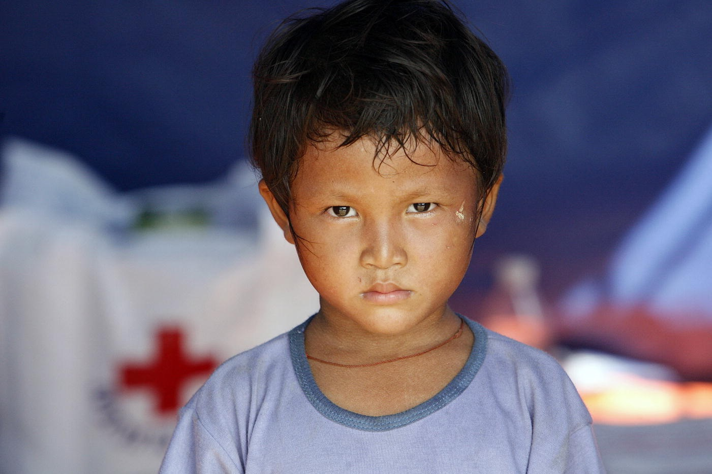
  “…faith-based organisations [in Myanmar] have acted as buffers between warring parties and were hence able to operate in both areas, even at the peak of the conflict. Due to the trust they benefitted from, they were good advocates for protection. They lobbied the government to take full responsibility for the education and health services of IDPs in Kachin state. No other international organisation or local NGO has such a wide margin of manoeuvre to respond to the humanitarian situation.”
http://www.unhcr.org/539ef28b9.html
Notes:
Survivor of cyclone "Nargis" residing in an Internally Displace Persons camp, consisting of 104 tents donated by the governments of China and India, situated in the Ayeyarwady delta region.
Photo ID 178562. 22/05/2008. Bebaye Township, Myanmar. UN Photo/Evan Schneider. unmultimedia.org/photo/

Slide 55
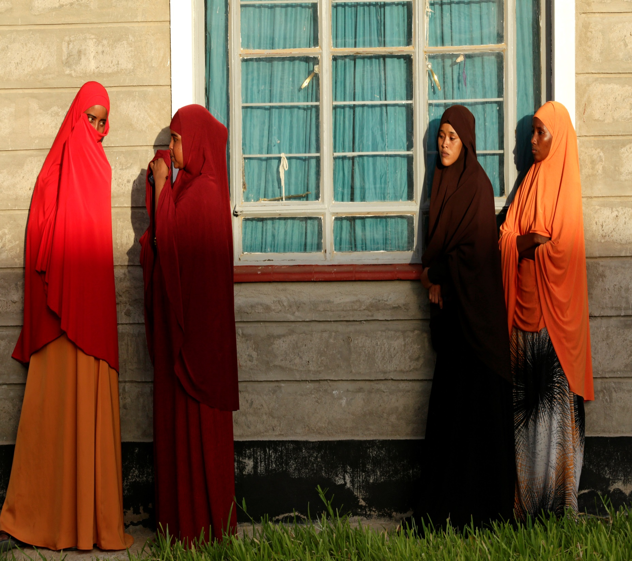
  “…[a] study of female IDP Kikuyu victims of gender based violence in Kenya found faith communities the only actors to provide women trauma counseling in this context…”

Slide 56
  ‘Basic needs’ in humanitarian situations are often highly gendered and intimately related to the religious identity and belief system of refugees and IDPs, with local conceptualisations of ‘basic needs’ often transcending secular organisations’ perceptions. For instance, UNFPA noted that many Muslim IDP women affected by the Indian Ocean Tsunami of 2004 held that headscarves were essential to maintain their dignity and were a prerequisite to be able to access other services in public spaces…’
Dr Elena Fiddian-Qasmiyeh, UCL

Slide 57
  A study in Irbid (Jordan) conducted by Islamic Relief revealed that when Muslim refugee women from Syria arrived in Jordan they often approached Muslim faith leaders for support, and mosques have become a new safe space for Syrian refugee women and girls…In contrast, the study confirmed that many refugee men from Syria avoid these since they continue to view faith leaders and mosques as being part of a political system they do not trust…

Slide 58
Recommendations
  Encourage donors to purposefully apply a gender and faith sensitive lens
  Identify what roles, if any, religious institutions and faith leaders can play in lifting barriers and ensuring safety and dignity of women and girls
  Avoid making assumptions about what women and girls want and who ‘leaders’ are
  Assess potential partners on various issues relating to gender, with neither faith-based nor secular organizations assumed to be ‘better’ for gender equality
  Develop greater flexibility to be able to listen to, and respond to, refugees’ gendered and faith-based needs
#hashtag

Slide 59
II. Lessons from gender and development – social norms work

Slide 60
Defining ‘norms’
The shared expectations or informal rules among a set of people as to how people should behave
Norms (from ALIGN materials): The often implicit, informal rules which people abide by, held in place by beliefs, behaviors and practices and bound into the values people and societies accept. Norms are embedded in formal and informal institutions and produced and reproduced through social interaction.
Gender norms: Informal rules and shared social expectations that distinguish the kind of behaviour expected from a person on the basis of their gender. For example, a common gender norm is that women and girls will and should do the majority of housework.

Slide 61
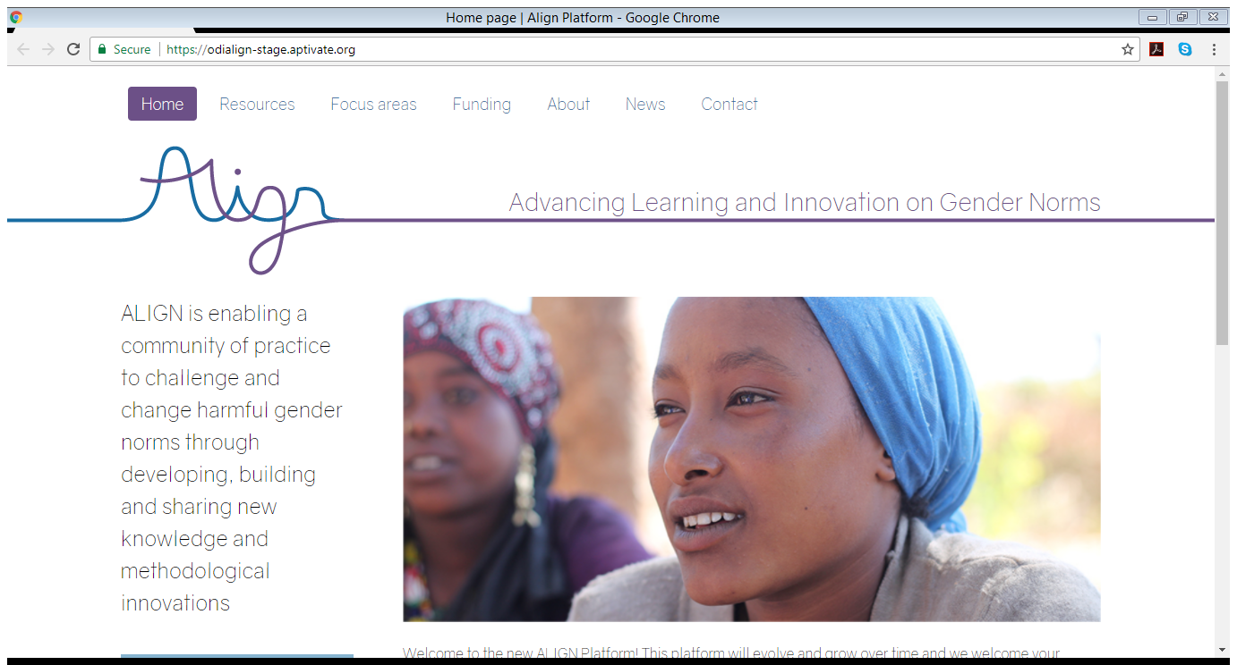
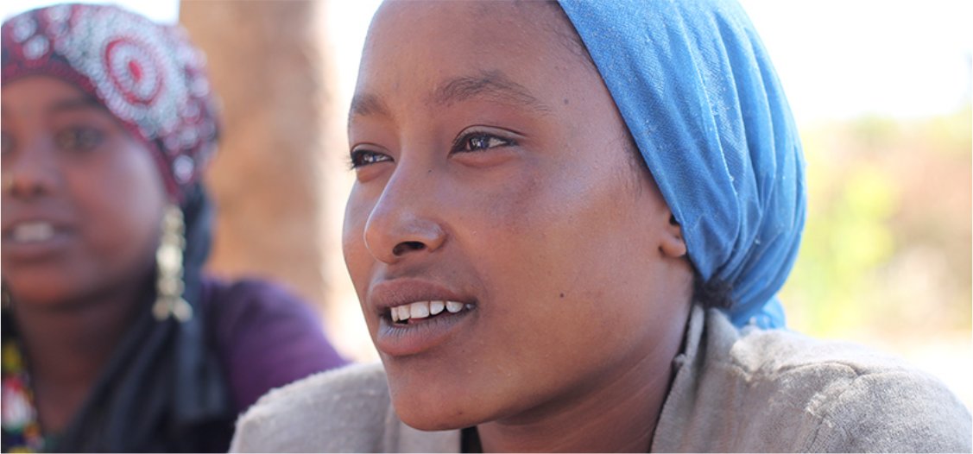

ALIGN is a four-year project which seeks to challenge and change harmful gender norms by connecting a global community of researchers and thought leaders committed to gender equality for adolescents and young adults.
Through the sharing of information and the facilitation of mutual learning, ALIGN aims to ensure knowledge on norm change contributes to sustainable gender justice.
Digital platform
Convenings in the North and South

Slide 62
Social norms work and conflict/disaster
  Periods of conflict or disaster can lead to change in gender norms – They can disrupt old beliefs and practices around masculinity and femininity, or lead people to break traditional gender roles, simply to survive (ex. Post earthquake female masons in Nepal)
    Political movements in conflict settings sometimes promote gender norm change (more egalitarian in Maoist movements in Nepal, more traditional for example in some Islamist movements in MENA)
  They can also lead to a backlash
#hashtag

Slide 63
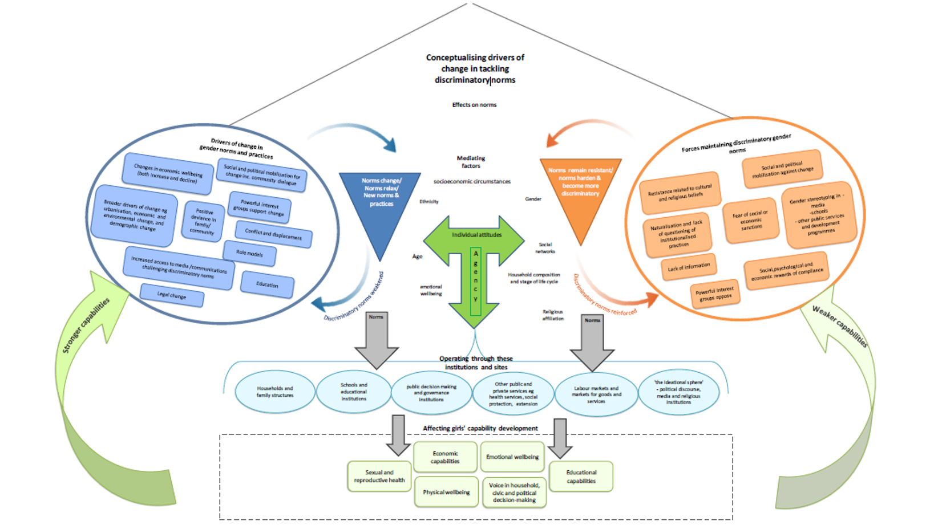

Slide 64
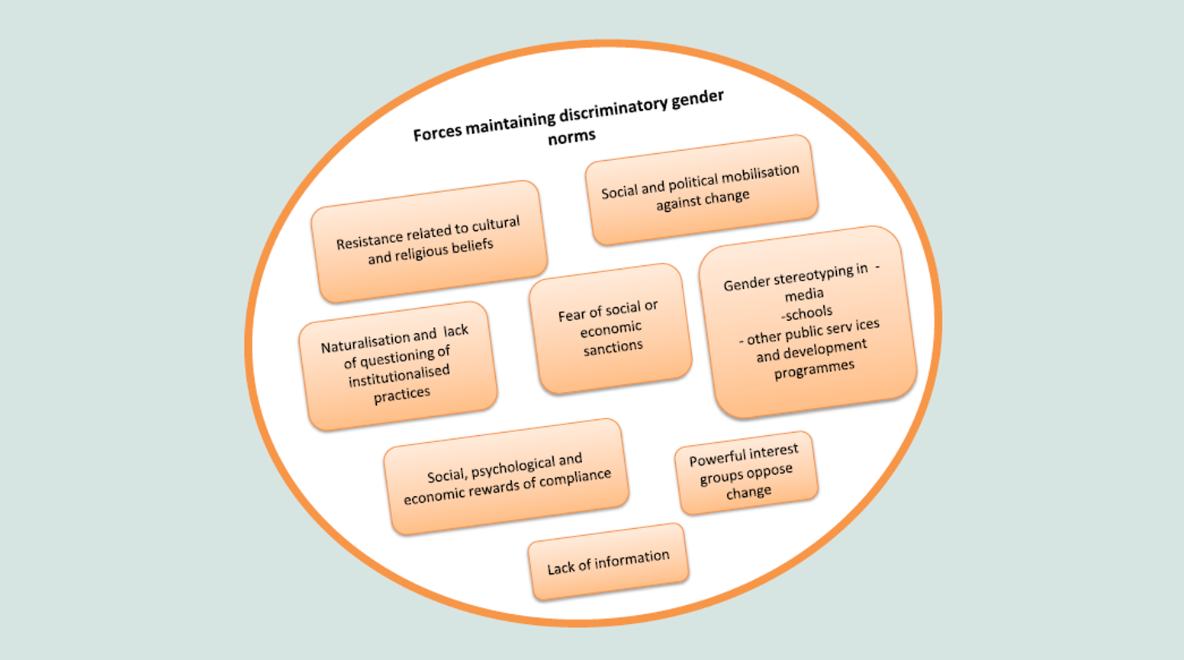

Slide 65
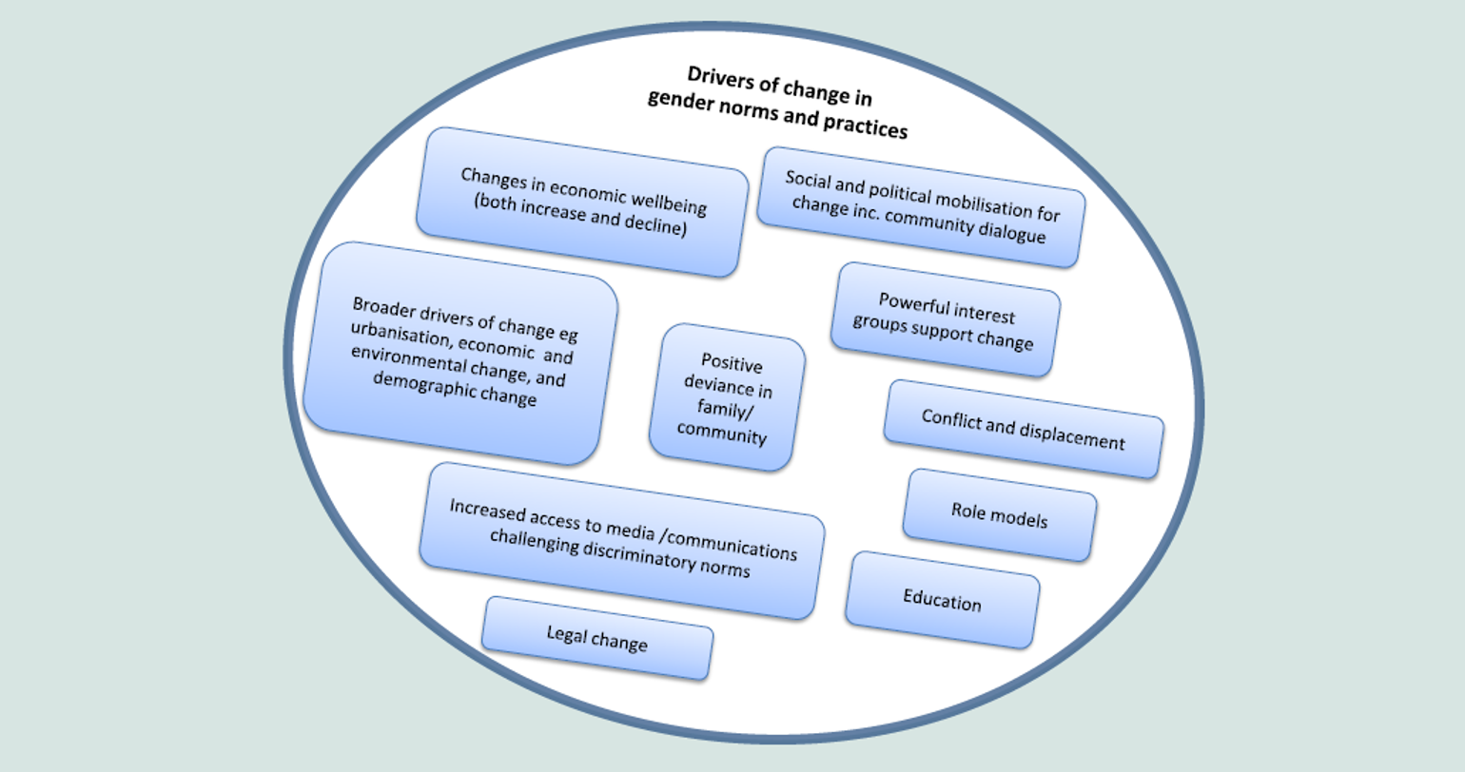

Slide 66
Recommendations
  Consider the role that gendered social norms play in conflict/disaster and the local organizational structure
  Better understand the ways that conflict/disaster may disrupt (positively or negatively) once deeply entrenched social norms and the implications for refugees, IDPs, emergency victims and others (particularly related to mental health and psychosocial wellbeing)
  Humanitarian aid must look to history and integrate a deeper understanding of what sustainable change looks like given lessons learned about gendered social norms and conflict/disaster
#hashtag

Slide 67
III. Questions for discussion

Slide 68
Questions for discussion
  How can the Grand Bargain be improved to integrate a gender mainstreaming that is sensitive to gendered social norms?
  How can we engage better in light of the Grand Bargain with local religious and belief systems and their complex interactions with gendered experiences to achieve social and gender justice in humanitarian contexts?
  How can we best take advantage of the potential for ‘breaking’ harmful gendered norms in disaster and conflict contexts to promote the long-term wellbeing of women and girls? gender engagement during crises, where social norms are often relaxed or suddenly changed?
#hashtag

Slide 69
Questions?
R.George@odi.org.uk

Slide 71
As part of the Grand Bargain pilot projects & field initiatives, how do we hand over power to ensure local women have the opportunity to take leadership in emergency response?
At your table, please come up with three actions that could be undertaken to hand over power. We will invite each table to present back your thoughts to the wider group after 30 minutes.

Slide 72
Thank you!
27th October
Grand Bargain: Strengthening Engagement between Humanitarian and Development Actors and Multiyear Planning and Funding
For more information visit: http://dochas.ie/grand-bargain
https://actionaid.ie

