Slide 1
Agroecology and the climate crisis

Slide 2
True or false
Human activities, through emissions of greenhouse gases, have caused global warming.
True.

Slide 3
True or false
Climate change is already affecting weather and climate extremes in every region across the globe, with negative impacts to nature and people.
True

Slide 4
True or false
Vulnerable communities who have contributed the least to current climate change are the most impacted by climate change.
True

Slide 5
True or false
There is nothing we can now do about climate change.
False - some future changes are unavoidable but can be limited by deep, rapid and sustained global greenhouse gas emissions reduction.
Intergovernmental Panel on Climate Change

Slide 6
What are the main causes of greenhouse gas emissions?
Burning coal, oil and gas. This includes transportation like cars and airplanes, heating our homes, using electricity and manufacturing products.
Cutting down forests (deforestation). Trees help to regulate the climate by absorbing CO₂ from the atmosphere. When they are cut down, that beneficial effect is lost and the carbon stored in the trees is released into the atmosphere, adding to the greenhouse effect.
Increasing livestock farming. Cows and sheep produce large amounts of methane when they digest their food.
Fertilisers containing nitrogen produce nitrous oxide emissions.

Slide 7
What are the main causes of greenhouse gas emissions?
Burning coal, oil and gas are the biggest source of greenhouse gas emissions, however the next biggest source is agriculture which is associated with cutting down forests, livestock farming and fertilisers.

Slide 8
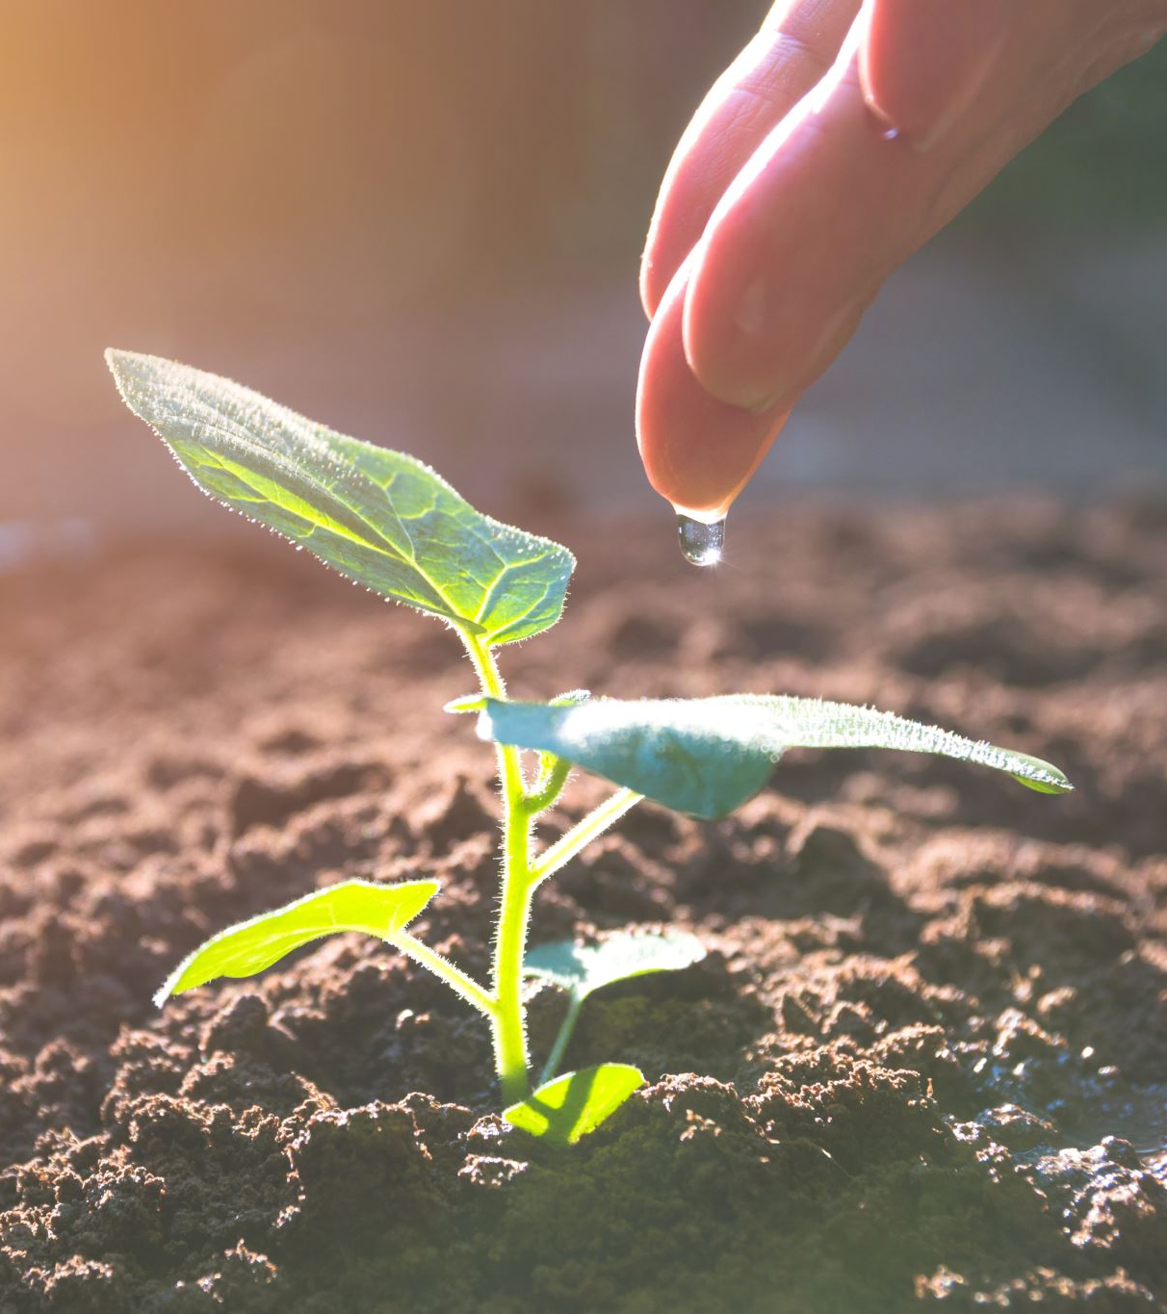
What is agroecology?
Agroecology is sustainable farming that works with nature, rather than against it.
By adding nutrient and carbon-rich organic matter such as compost and manure to soils, agroecology avoids the need for climate-harming and soil-degrading synthetic nitrogen fertilisers.
Agroecology promotes biodiversity by planting multiple varieties of crops.
Rich, naturally healthy soils can lead to abundant yields.

Slide 9
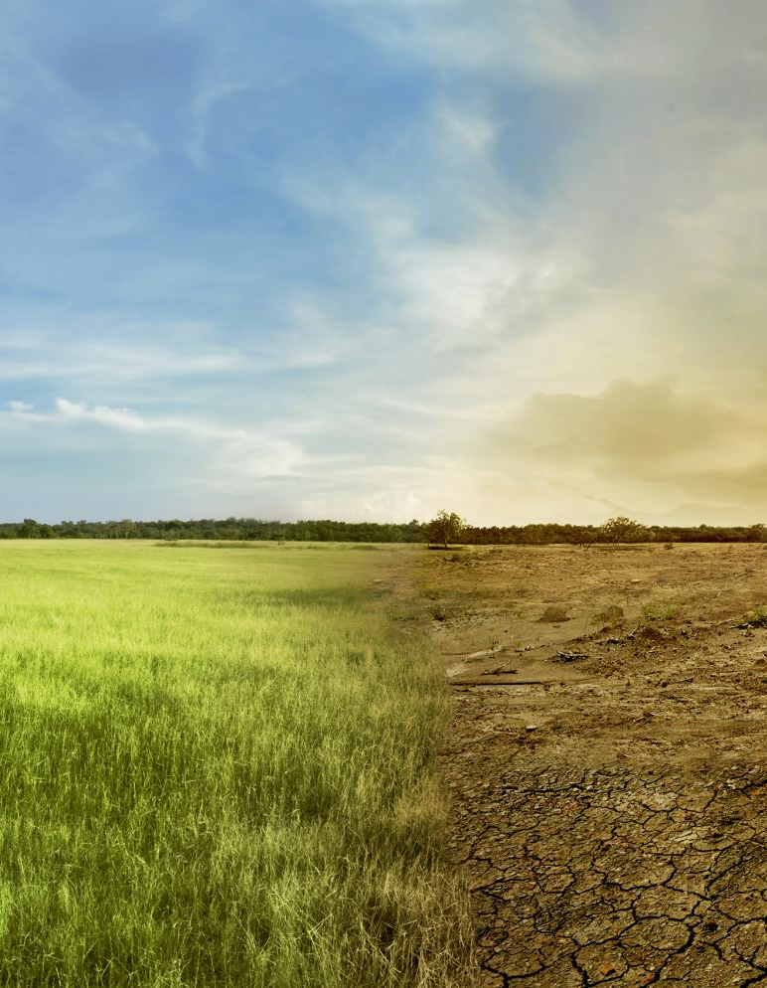
Climate benefits of agroecology
Mitigation
Avoids the use of nitrogen fertilisers which are made using fossil fuels
Soils, trees and multiple crop layers absorb carbon
Avoids biodiversity loss and deforestation
Adaption
Soils packed with organic matter are spongy and so retain water. That means in times of drought water is available to crops for much longer.
Improving soils and adding trees reduces the risk of flooding in times of heavy rainfall.
Increased crop and seed diversity reduces the chances of total crop failure.

Slide 10
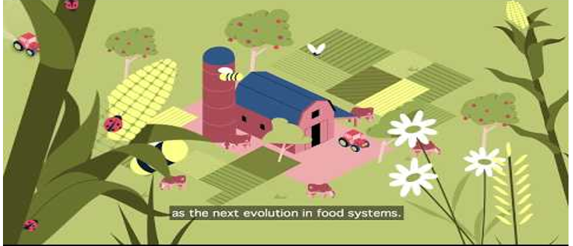
What is agroecology?

Slide 11
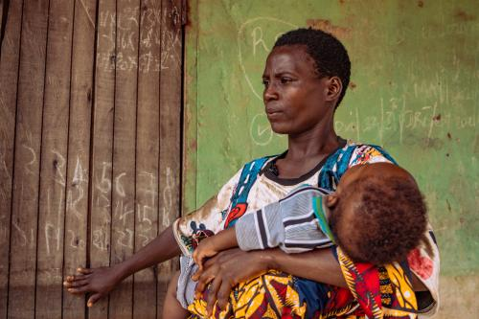
Case study:
Agroecology has been used over the past number of years to support farmers who are already experiencing the effects of climate change and rising food and fertiliser prices.
Martha Isaac, a farmer and mother from Otutuoma, Nigeria: “The flood in 2022 chased me from where I was staying before to this place. I thought I had escaped the flood, but it still affects this area. Our cassava was destroyed and even the ones that the flood did not touch, when we got there after the flood, it had got rotten.
“ActionAid taught us agroecology; and it has helped us. We no longer buy chemical fertilizers. They taught us to make our own fertilizers. We store our leftovers, cassava peels, to make our own manure. We no longer waste money buying fertilizers. From this knowledge I can also teach other people how to make manure and they can also save their money.”
Photo taken by: Nora Awolowo/ActionAid

Slide 12
Class Discussion
Do you think agroecology is a solution to the climate crisis?
How can it help?
What are the challenges of agroecology?
What do consumers need to do to support agroecology and cut down on emissions from food?
What are the limitations of agroecology?
Do you think we can feed the world in a way that is environmentally respectful and sustainable?

Slide 13
Reflection: Some questions to ask
What had you heard about farming and climate change before and where had you heard about it? (from media, friends and family, just around)
Who has the power and control when it comes to climate change? Who loses and who benefits?
Whose perspectives do you usually hear from when it comes to climate action and farming?

Slide 14
Actions to take
Talk about climate change with your friends and family
Discuss as a class ways that you can work together with your community on climate action.
Write to your local politician or local newspaper outlining the changes that you would like to see

Slide 15
Actions to take
Take part in ActionAid’s ActionTalks speech writing competition, writing a speech on the topic:
Agroecology, which is farming that works with nature, is one solution to the climate crisis at home and abroad. Discuss making reference to women’s rights.
First prize is a €500 voucher – learn more at www.actionaid.ie

Slide 16
Further reading
IPCC Report – Climate Change 2023 https://www.ipcc.ch/report/ar6/syr/downloads/report/IPCC_AR6_SYR_SPM.pdf
Shifting Funding to Agroecology: https://www.actionaidusa.org/publications/shifting-funding-to-agroecology-fo-people-climate-and-nature/
Agroecology scaling up and scaling out: https://www.actionaidusa.org/publications/agroecology/
Principles for a Just Transition in Agriculture: https://www.actionaidusa.org/publications/principles-for-a-just-transition-in-agriculture/
Why food production is central to the crises we face: https://www.actionaidusa.org/insight/back-to-the-land-why-food-production-is-central-to-the-global-crises-we-face/
How the Finance flows: The banks fueling the climate crisis and Ireland’s role in enabling this https://actionaid.ie/wp-content/uploads/2023/09/ActionAid-Ireland-How-the-Finance-Flows.pdf

