Slide 1
Gender-based violence and crises

Slide 2
What is gender-based violence?
Any harmful act that is perpetrated against a person that is based on gender norms and unequal power relationships.
Gender-based violence includes domestic violence, child marriage, FGM, physical and emotional violence (such as coercive control), sexual harassment, murder, abduction, verbal violence (including hate speech, threats and name calling), stalking, online publication of images, sexual activity without consent, economic violence (often affecting lone parents).
Gender based violence inflicts harm on women, girls, men, boys, transgender, intersex and non-binary individuals and is a severe violation of several human rights.

Slide 3
True or false
1 in 3 women worldwide will experience violence in their lifetime, most likely at the hands of someone they know.
True. (Source: WHO)

Slide 4
True or false
5 women are killed every hour by their partner or family member.
True. (UN Women)

Slide 5
True or false
One million girls are married before the age of 18, every year.
False – it’s actually 12 million girls who are married before the age of 18 every year. (Girls Not Brides)

Slide 6
True or false
Child marriage is decreasing overall but increasing in the poorest countries.
True. (The Guardian)

Slide 7
True or false
Globally, 10 percent of employed men and women said they had experienced psychological violence and harassment in their working life.
False, it is actually 17.9 percent. (ILO)

Slide 8
True or false
University of Galway research found that 96% of those surveyed had received abusive social media messages containing hate speech, foul language and inappropriate comments.
True (University of Galway)

Slide 9
True or false
Sustainable Development Goal 5 on Gender Equality is going to be achieved by 2030
False – it is off track, reflecting and affecting the progress of all of the SDGs. Without change, it could take close to another 300 years to achieve full gender equality. (UN)

Slide 10
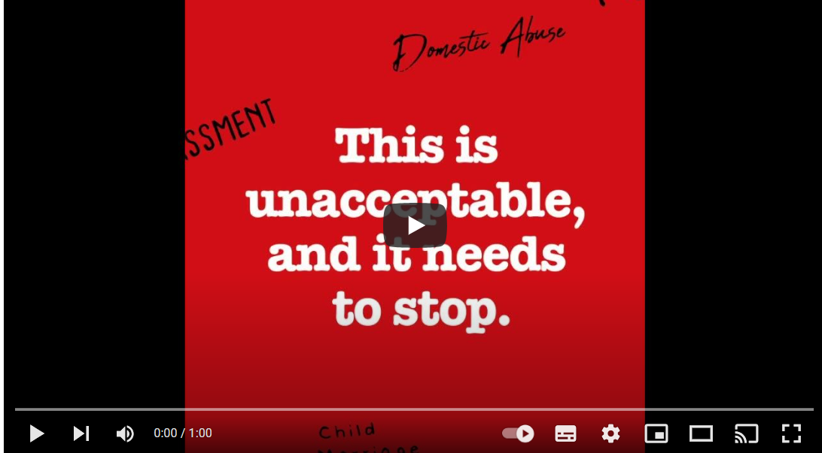

Slide 11
What is a crisis?
A crisis is a time of increased difficulty of danger. They can include war, drought, hunger, flooding, rising costs, or a pandemic.
At the moment the climate crisis is increasing drought, hunger and flooding across the world and the war in Ukraine is increasing prices of basic items like food and fuel in the most marginalised communities.

Slide 12
How do you think crises impact gender-based violence?
Women are several times more likely to die from climate disasters as men and the greater the gender and economic inequality, the greater the disparity.
When climate change leaves families hungry, women report higher incidences of domestic violence.
When water sources dry up, women and girls must walk further to fetch water, leaving them vulnerable to violence.
When crop failure impacts on family income, women tend to skip meals more than men.
Girls are pulled out of schooling before their brothers either to save on school fees or to send them to fetch water, setting them on an unequal path for life.
During times of disaster, girls are married off at an early age by parents who can no longer afford to feed them, depriving them of schooling and exposing them to gender-based violence.
Gender-based violence increases during times of war and conflict. In some conflicts, it is used as a weapon of war to create fear and terrorize populations.

Slide 13
Class Discussion
What can be done to end gender-based violence in Ireland and internationally?

Slide 14
Reflection: Some questions to ask
What had you heard about gender-based violence before and where had you heard about it and how had this influenced your opinion? (from media, friends and family, just around)
Who loses and who benefits when it comes to gender-based violence? (Considering the impact that the fear of gender-based violence has).
What systems and structures lead to an increase in gender-based violence?

Slide 15
Actions to take
Talk about climate change with your friends and family
Write a letter to your local newspaper or local politician about actions that you would like to see taken to end gender-based violence.

Slide 16
Actions to take
Take part in ActionAid’s ActionTalks speech writing competition, writing a speech on the topic:
Rates of gender-based violence are increasing due to conflict and climate change. What can Ireland do?
First prize is a €500 voucher – learn more at www.actionaid.ie

Slide 17
Further reading
https://www.who.int/news-room/fact-sheets/detail/violence-against-women
https://www.concern.net/news/solutions-to-gender-based-violence
https://www.rescue.org/uk/article/what-gender-based-violence-and-how-do-we-prevent-it
https://www.unwomen.org/en/news-stories/feature-story/2022/11/push-forward-10-ways-to-end-violence-against-women
https://www.gbv.ie/wp-content/uploads/2023/03/CSW67-Technology-and-Gender-Based-Violence-Risks-and-Opportunities.pdf
https://www.gbv.ie/wp-content/uploads/2022/03/ICGBV-Policy-Paper-Climate-Change-and-GBV.pdf
https://www.toointoyou.ie/what-is-abuse/red-flags-for-abuse/

