Slide 1

Loss and Damage
Responding to the harms caused by climate change

Slide 2
Power Walk
The Power Walk is a group exercise that facilitates participants to “walk” in someone else's shoes.
Six volunteers will be given six personas and then asked eight questions.
At the end of the activity, the distance walked represented one’s power and access to resources over others.

Slide 3
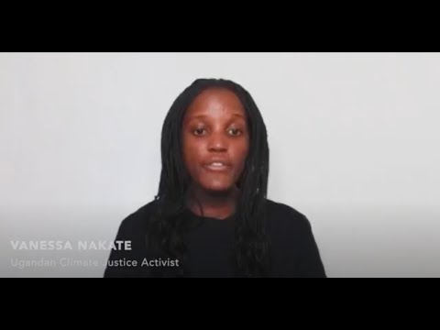
Loss and Damage - and Who Should Pay For It
https://www.youtube.com/watch?v=96wtZnglTCQ

Slide 4
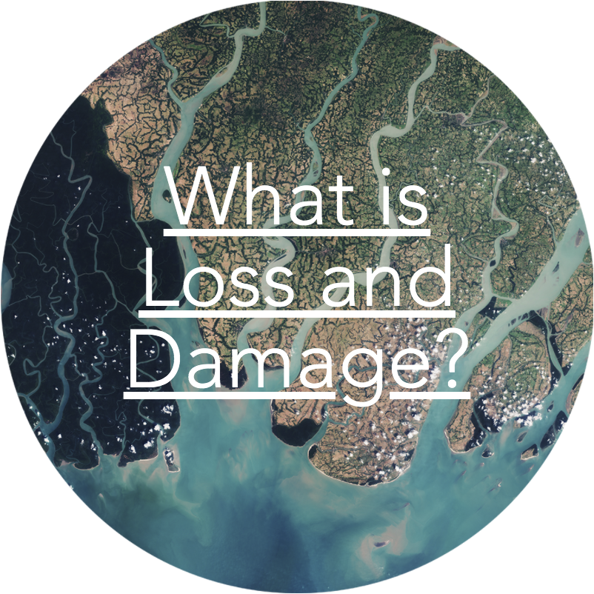
What does loss and damage mean?
Because of climate change, half of the world is now in a danger zone.
But there is no support mechanism for countries already affected by the crisis.
“Loss and Damage” is the funding that campaigners are calling for so that communities already affected by climate change can cope.

Slide 5
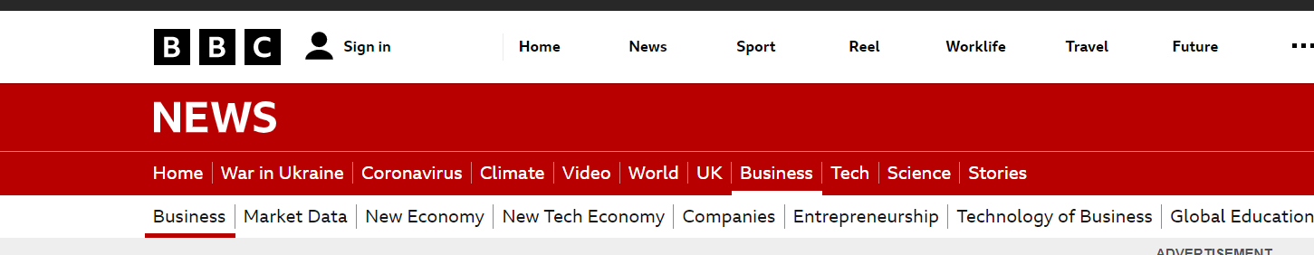
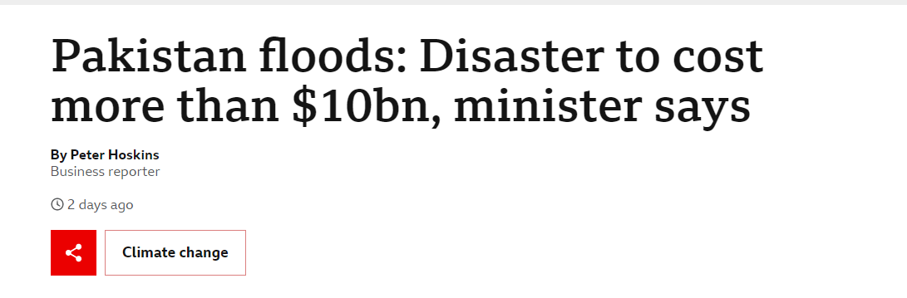
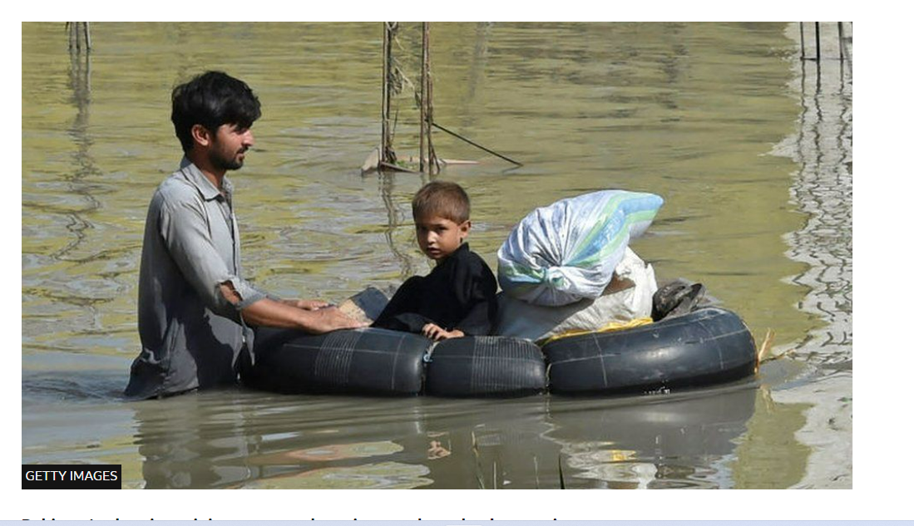
Case Study
Pakistan, the world’s fifth largest country, but has contributed less than 1% of the global greenhouse gas emissions.
In August 2022, devastating monsoon rains in Pakistan killed over 1,000 people and left over 33 million people homeless. Over 1/3 of the country was submerged under water.

Slide 6
Class Activity
What are the ways rich countries and companies have contributed to climate change?
What are the ways that poorer countries have been impacted by climate change?
What are the solutions?

Slide 7
Reflection: Some questions to ask yourself
What had you heard about loss and damage or generally on climate action before before and where had you heard about it? (from media, friends and family, just around)
Who has the power/control when it comes to loss and damage? Who loses and who benefits?
Whose perspectives do you usually hear from when it comes to climate action?

Slide 8
Take Action
Talk about climate change and loss and damage with your friends and family
Discuss as a class ways that you can work together with your community on climate action.
Write to your local politician asking them to support loss and damage payments
Write a letter to your local newspaper about loss and damage and why it is important

Slide 9
Take Action
Take part in ActionAid’s ActionTalks speech writing competition – writing a speech on the topic:
"Current efforts to reduce greenhouse gas emissions and adapt are not enough to tackle the speed and scale of climate change, meaning that some losses and damages from climate change are inevitable. Women and children in particular are on the front line. Rich countries should pay their fair share for the loss and damage their energy consumption has caused in poorer nations.”
First prize is a €500 voucher – learn more at www.actionaid.ie

Slide 10
Further Reading
ActionAid Avoiding the Climate Poverty Spiral: Social protection to avoid climate-induced loss & damage: https://actionaid.org/publications/2021/avoiding-climate-poverty-spiral-social-protection-avoid-climate-induced-loss
Oxfam Footing the Bill Report: https://www.oxfam.org/en/research/footing-bill-fair-finance-loss-and-damage-era-escalating-climate-impacts
Loss and Damage Collaboration: https://www.lossanddamagecollaboration.org/whatislossanddamage
Loss and Damage Why & How https://climatenetwork.org/resource/ldff-paper/
The Guardian: https://www.theguardian.com/environment/2021/nov/13/what-is-loss-and-damage-and-why-is-it-critical-for-success-at-cop26

