Slide 1
Care work and poverty

Slide 2
What is care work?
Care work includes looking after the physical, psychological, emotional and developmental needs of one or more other people and can also include care for the environment.
It can be paid or unpaid.
Everyone needs care at some point in their life.
Care can often be seen in two ways that are often combined – there is ‘caring about’ (emotional labour) and ‘caring for’ (carrying out the practical work of care).

Slide 3
True or false
Women perform over three quarters of the unpaid care and domestic work that is done worldwide.
True!

Slide 4
True or false
There are equal men and women in power in most countries making decisions on things like childcare, paid parental leave and minium wage.
False!

Slide 5
True or false
16.4 billion hours per day are spent in unpaid care work – the equivalent to 2 billion people working eight hours per day with no pay.
True!

Slide 6
True or false
16.4 billion hours per day are spent in unpaid care work – the equivalent to 2 billion people working eight hours per day with no pay.
True!

Slide 7
True or false
Ireland has the third highest weekly hours of unpaid work for both men and women across the EU28, reflecting the low State involvement in support for caring.
True!

Slide 8
True or false
There is equal paternity and maternity leave for men and women in most countries.
False!

Slide 9
True or false
Care is recognised as a human right and everyone has a right to be cared for.
False – though there is a campaign to make care a human right

Slide 10
Can you think of different kinds of care work?

Slide 11
Care work around the globe
ActionAid works with women who spend up to 18 hours a day on unpaid work.
Jobs like cooking and cleaning are more difficult in the poorest communities, where not only are there no time-saving devices such as dishwashers and washing machines, but there is often no mains water or electricity.
Many women must walk for miles to fetch water or firewood before even starting their household chores.

Slide 12
Care work around the globe
In some cases, care work falling to women can be due to social reasons (for example assumed roles of women; men being given priority in public spaces and in decision-making positions).
In other cases, it can be because governments do not provide basic services like water, electricity, or schools close to where people live). Often governments don’t have funds to provide services due to due to debt, tax avoidance by multi-national corporations, and unfair rules set out by global organisations like the International Monetary Fund.
The impact of this imbalance is severe. As long as women and girls are forced to spend their time in this way, they will be blocked from getting jobs, an education, participating in political decision making or having any rest or leisure time.

Slide 13
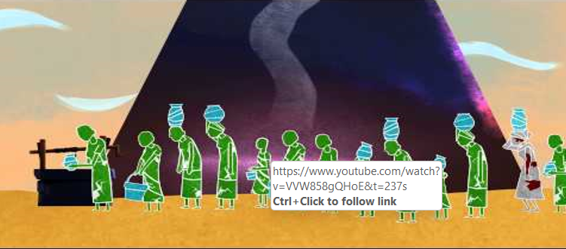
Unpaid care work and poverty

Slide 14
Class Discussion
Right now, a majority of care work is unpaid and done by more women than men.
Who should be responsible for care work?
How can men take more responsibility?
How can governments take more of the responsibility?

Slide 15
Reflection: Some questions to ask
What had you heard about care work before and where had you heard about it and how has this influenced your opinion? (from media, friends and family, just around)
What would a world without care look like?
Who loses and who benefits when it comes to unpaid care?
What can the government do differently to encourage and celebrate the importance of care in our society?

Slide 16
Actions to take
Think about who does the most care in your home and see how you can make it fairer! – you could use a time diary in your own home.
Write a letter to your local newspaper on the importance of regognising the value of care work.

Slide 17
Actions to take
Take part in ActionAid’s ActionTalks speech writing competition, writing a speech on the topic:
Structural change is needed to tackle unpaid care work, which keeps women and girls in poverty by preventing them from going to school or earning an income.
First prize is a €500 voucher – learn more at www.actionaid.ie

Slide 18
Further reading
ActionAid Who Cares report: https://actionaid.org/publications/2020/who-cares-future-finance-gender-responsive-public-services
ActionAid the care contradiction report: https://actionaid.org/publications/2022/care-contradiction-imf-gender-and-austerity
Oxfam unpaid and underpaid care and the global inequality crisis: https://www.oxfam.org/en/research/time-care

