Slide 1
Who cares?
Why care should be the responsibility of everyone in society

Slide 2
What is care work?
Care work includes looking after the physical, psychological, emotional and developmental needs of one or more other people.
It can be paid or unpaid.
Everyone needs care at some point in their life.

Slide 3
Class Activity
Can you name some different kinds of care work?

Slide 4
True or false
Women perform over three quarters of the unpaid care and domestic work that is done worldwide.
True!
On average women spend four hours and 25 minutes daily doing unpaid care work, in comparison to men’s average of just one hour and 23 minutes.
True!
16.4 billion hours per day are spent in unpaid care work – the equivalent to 2 billion people working eight hours per day with no pay.
True!
Care is recognised as a human right and everyone has a right to be cared for.
False – though there is a campaign to make care a human right

Slide 5
Case study: Unpaid Care Work in Vietnam
Duong Van Pa, 34, and Vuong Thi Sung, 29, have three young children and are from the H’Mong ethnic minority group. Pa said: “According to our tradition, women had to take good care of the housework so their husbands could go out to make a living for the family.”
Pa said: “My wife Sung often complained about the heavy workload at home.”
  She had to wake up at 4 am to feed the pigs and chickens.
  Then cook breakfast.
  She cleaned the house.
  Tended the vegetables and herbs in our small garden.
  Cut some hay, washed dirty clothes,
  Prepared meals.
  When the children were home, she bathed them.
  And fed the smallest one while we all had dinner.
“I sometimes helped her with teaching the children, but that was it. She was extremely sad and exhausted.”
Pa is one of 5,670 people taking part in the Unpaid Care Work Programme implemented by ActionAid Vietnam, with support from ActionAid Ireland. The programme includes conducting time-diary surveys, community behaviour-change initiatives, policy analysis and advocacy.

Slide 6
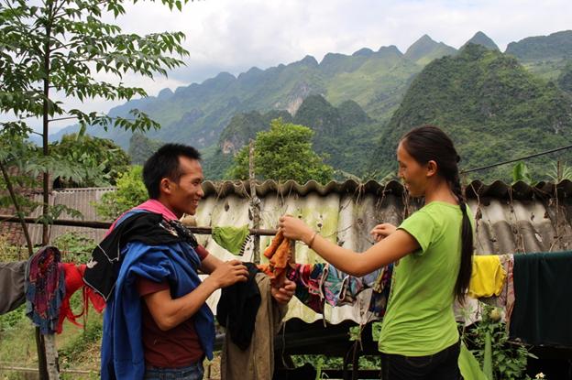
Case study: Unpaid Care Work in Vietnam
Pa continued: “For the first time, I recognised the burden put on my wife’s shoulders. She was suppressed of her right to participate in social and political activities because all her time was used for unpaid care work. She was silenced.”
ActionAid Vietnam made recommendations for alternative policy approaches to the Government of Vietnam to reduce and redistribute unpaid care work. As a result, the Vietnamese ministry responsible for gender equality has decided to include unpaid care work as one of the indicators to assess how much progress Vietnam has achieved in terms of equality.
Photo caption: Pa and Sung in their garden. Photo by ActionAid Vietnam.

Slide 7
Class activity
Right now, a majority of care work is unpaid and done by more women than men. What would be a better way to organize care?

Slide 8
Why does this matter in Ireland
Article 41.2 of the Irish Constitution states:
  1° In particular, the State recognises that by her life within the home, woman gives to the State a support without which the common good cannot be achieved.
  2° The State shall, therefore, endeavour to ensure that mothers shall not be obliged by economic necessity to engage in labour to the neglect of their duties in the home.
There is a recommendation to hold a referendum in 2023 on this Article. This is an opportunity to not only remove misogynistic language but also an opportunity to enhance the importance of care within our Constitution.

Slide 9
Reflection: Some questions to ask
What had you heard about care work before and where had you heard about it? (from media, friends and family, just around)
Who loses and who benefits when it comes to unpaid care?
What systems and structures have caused care to be organized in such a way?

Slide 10

Actions to take
Write a letter to your local newspaper on the importance of regognising the value of care work.
Talk about unpaid care with your friends and family – you could use a time diary in your own home.

Slide 11
Actions to take
Take part in ActionAid’s ActionTalks speech writing competition, writing a speech on the topic:
"Care, both paid and unpaid, while largely a burden for women, is the responsibility of everyone in society and there should be a human right to care. Discuss."
First prize is a €500 voucher – learn more at www.actionaid.ie

Slide 12
Further reading
ActionAid Who Cares report: https://actionaid.org/sites/default/files/publications/Who%20Cares%20-%20Summary%20Report%20-%20final%20revised.pdf
Oxfam Time to Care report: https://oxfamilibrary.openrepository.com/bitstream/handle/10546/620928/bp-time-to-care-inequality-200120-summ-en.pdf
National Women's Council of Ireland: https://www.nwci.ie/discover/what_we_do/valuing_care_and_care_work
Oireachtas Committee recommendation on 2023 referendum https://www.oireachtas.ie/en/press-centre/press-releases/20220713-gender-equality-committee-recommends-referendum-on-woman-in-the-home-section-of-constitution-should-be-held-in-2023/
Care systems and SDGs: reclaiming policies for life sustainability: https://www.2030spotlight.org/en/book/1730/chapter/4-care-systems-and-sdgs-reclaiming-policies-life-sustainability

