Slide 1

Campaigning for a fossil fuel free future and for climate action

Slide 2
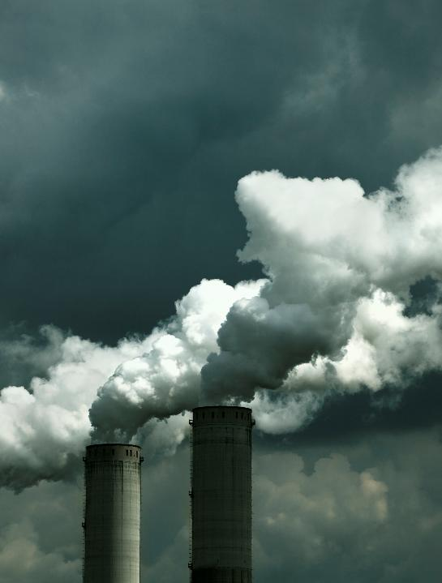
What are fossil fuels?
Fossil fuels are energy sources such as coal, coal products, natural gas, derived gas, crude oil, petroleum products and non-renewable wastes.
These fuels originate from plants and animals that existed in the geological past (for example, millions of years ago).
They can be also made by industrial processes from other fossil fuels (for example in the oil refinery, crude oil is transformed into motor gasoline).
When burned, they release carbon dioxide (CO₂) – a greenhouse gas.
Read more

Slide 3
Why are fossil fuels harmful?
Main effects:
Burning fossil fuels releases greenhouse gases.
These gases trap heat in the atmosphere → global warming.
Pollutes air and water
Extracting fossil fuels damages ecosystems
Climate impact: Extreme weather, rising sea levels, droughts, and floods.

Slide 4
True or false
Fossil fuels are the second largest contributor to global climate change.
False. Fossil fuels – coal, oil and gas – are by far the largest contributor to global climate change, accounting for over 75 per cent of global greenhouse gas emissions and nearly 90 per cent of all carbon dioxide emissions.
Source: https://www.un.org/en/climatechange/science/causes-effects-climate-change

Slide 5
True or false
The 2024 Global Carbon Budget key findings state that globally, emissions from different fossil fuels in 2024 are projected to increase.
True. Globally, emissions from different fossil fuels in 2024 are projected to increase: coal (0.2%), oil (0.9%), gas (2.4%). These contribute 41%, 32% and 21% of global fossil CO₂ emissions respectively.
Watch more, here.
Source: https://globalcarbonbudget.org/fossil-fuel-co2-emissions-increase-again-in-2024/

Slide 6
True or false
Current collective plans to mitigate climate change are in line with the numbers set for the reduction of greenhouse gas emissions needed by 2030 to limit the global temperature increase to 1.5°C by the end of the century.
False. Current collective plans to mitigate climate change fall significantly short of the greenhouse gas emissions reduction needed by 2030 to limit global temperature rise to 1.5°C by the end of the century.
Source: https://documents.un.org/doc/undoc/gen/g25/070/22/pdf/g2507022.pdf
https://unfccc.int/process-and-meetings/the-paris-agreement/nationally-determined-contributions-ndcs/2024-ndc-synthesis-report

Slide 7
True or false
Ireland’s emissions per person are among the highest in the EU.
True. We rely heavily on imported fossil fuels.
Main sources: agriculture (especially methane from cows), transport, and energy.
While small in population, our lifestyle and consumption patterns have a big impact.
Source: The hidden truth: Ireland’s role in the global fossil fuel industry
Click here to read the hidden truth of Ireland’s role in the fossil fuel industry

Slide 8
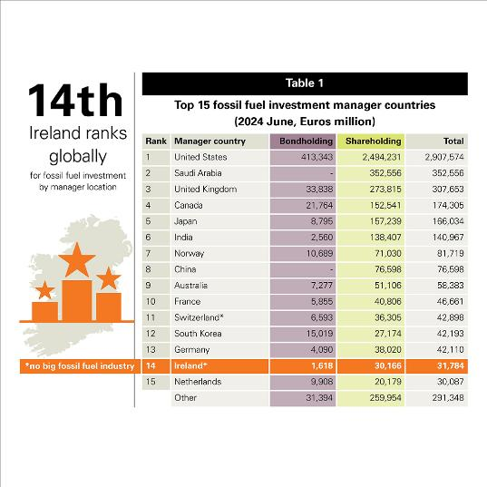
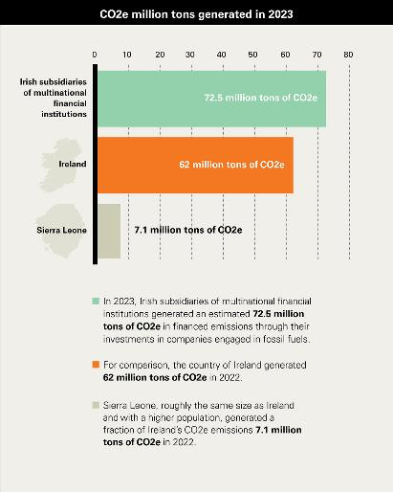
Source: https://actionaid.ie/the-hidden-truth/

Slide 9
Where do we use fossil fuels daily?
Think about your day from morning to night.
Where might fossil fuels be used?
List everything you use in one day that might rely on fossil fuels.

Slide 10
Where do we fit in?
Let’s think about our daily impact.
Which of these might use fossil fuels?
Food choices 🥩
Travel to school 🚗
Phone/computer usage 📱
Clothing choices 👕
Think of what you wore and ate today.
Where were these items made?
How did they reach you?
Could you make one small change to reduce your impact?
Create a “low-carbon day” plan for your school.

Slide 11
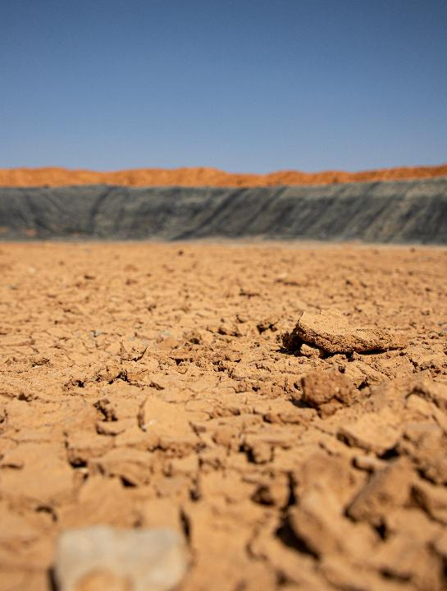
The climate crisis’ impact on the Global South
@Daniel ​Jukes/​ActionAid
Privileged lifestyles in Europe, North America and other nations in the Global North produce a carbon footprint 100 times greater than that of the world’s poor nations combined. Regions like Sub-Saharan Africa, parts of Asia, Latin America contributes the least to climate change but suffers the most.
The Global Risks Report 2025 confirms that the ranking of Extreme weather events has tended to rise as such events have worsened in intensity and frequency. These events are being felt across the world and often hit the poorest communities the hardest.
Sources: https://gceurope.org/global-north-and-global-south-how-climate-change-uncovers-global-inequalities/
https://www.weforum.org/publications/global-risks-report-2025/digest/

Slide 12
70%
600 million
1.8 billion
of the world’s poor depend on natural resources for all or part of their livelihoods
An estimated 600 million more people in Africa could face malnutrition as agricultural systems break down due to climate change impacts
An additional 1.8 billion people could face water shortages, especially in Asia
Source: https://www.actionaid.org.uk/our-work/emergencies-disasters-humanitarian-response/climate-change-and-poverty#footnote3_BbWSui4DWvJBoABIVbq29Gb3b5jXxdGtcguL3uxeSM8_zYFwm0rll93m

Slide 13

The climate crisis’ impact on the Global South
Wealthy countries, responsible for over 75% of global accumulated emissions since the start of industrialisation, have an obligation to support developing country climate action and pay for climate adaptation, the loss and damage caused by the impacts of climate disaster, and for a just transition away from fossil fuels to renewable energy and climate-resilient societies.
A 2023 study shows that by 2050 the Global North will owe US$192 trillion in fair reparations to the Global South – even if we can limit warming to an average 1.5°C.
Source: https://climatenetwork.org/2024/09/20/us5trillion-owed-to-global-south-by-global-north-due-to-the-climate-crisis/

Slide 14
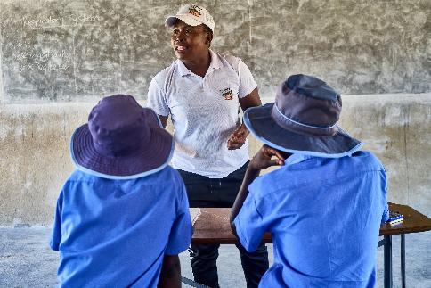
Case study
Synthia Ndawana is a health coordinator at a secondary school in Manicaland county, Zimbabwe. Here she conducts a lesson on the human respiratory system.
Synthia sees firsthand how underfunded public services and climate shocks are pushing girls out of school. As drought deepens hunger, more girls are dropping out school, often driven into early marriage or transactional sex to survive. With families unable to afford school fees due to loss of livelihood and a lack of support from the government, schools lack even basic resources like toilets, textbooks, and sanitary supplies. Girls miss out not just on education, but also on safe spaces and support networks.
Despite these challenges, Synthia highlights the vital role of local and international partners like ActionAid, who provide period pads and some educational support. But these efforts can only go so far without systemic change. Her story underscores the urgent need for fair financing and investment in public services to break the cycle of poverty, gender inequality, and climate vulnerability that girls in Zimbabwe face every day.
@Tendai ​Marima/​ActionAid | Synthia Ndawana, health coordinator at a secondary school in Manicaland county, Zimbabwe

Slide 15
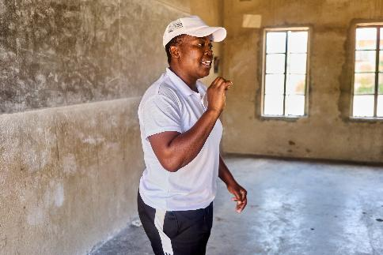
“The drought has a lot of problems that it creates; that children engage in sexual activities is because most of them are driven by the drought to do so because they are poor and therefore if they are given even an insignificant thing, they are easily lured into sexual activity which then leads to early marriages and again leading into school dropouts.”
“So drought is really bad in terms of -it leads girls to indulge in sexual activities for money; for a small amount of money. So, it is really bad.” - Synthia Ndawana talking about the drought (2023 -2024)
@Tendai ​Marima/​ActionAid | Synthia Ndawana, health coordinator at a secondary school in Manicaland county, Zimbabwe

Slide 16
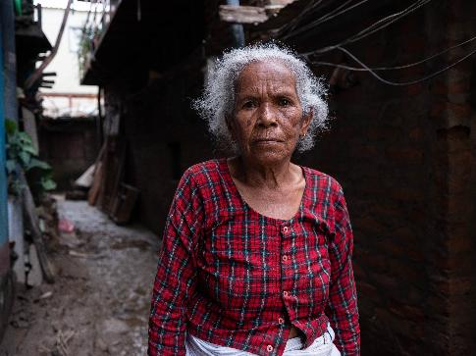
Case study
At 74, Thuli Maya faced one of the toughest challenges of her life when floods engulfed her village. “When the water came, I was terrified,” she recalls, her eyes reflecting the turmoil. “I never imagined I would have to leave everything behind.”
As the floodwaters rose, she and her son fled to a nearby field. “We had nowhere to go,” she says, her voice heavy with memory. “For days, I slept on that cold, wet ground, hugging myself just to feel warm.” The discomfort was unbearable, and the worry of what lay ahead gnawed at her.
Then, on October 1st, hope arrived. ActionAid Nepal and Nepal Mahila Ekata Samajh brought aid—mattresses and food supplies. Thuli’s face brightens as she remembers. “When I received that mattress, it felt like a blessing! I finally have a place to sleep.” “Before this, we went to bed hungry after the floods,” she continues. “Now I can cook whenever I want.” The joy in her voice contrasts sharply with the despair of those dark days.
@Uma ​Bista/​ActionAid | Thuli Maya, 74, affected by Nepal floods

Slide 17
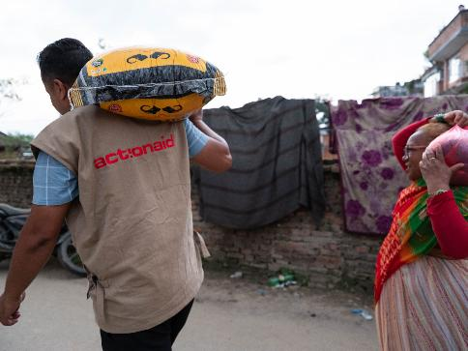
However, her kitchen remains a chaotic mess, a casualty of the flood. “I’m planning to put stones on the floor and create a proper kitchen,” she shares, determination shining through her words. “I want my home to feel safe and whole again.”
Thuli reflects on her rescue by the police, who offered to carry her away from danger. “I was hesitant,” she laughs lightly. “I didn’t want to be a burden.” Even with asthma worsening due to the conditions, her spirit remains high.
“I may have lost so much, but I still have my spirit,” she affirms, a glimmer of strength in her eyes. “I am so thankful for the help I’ve received.”
Each day, Thuli rebuilds her life, driven by the love for her son and her community. “Hope shines through, even in the darkest moments,” she concludes, her laughter ringing out as a testament to her enduring resilience.
@Uma ​Bista/​ActionAid | ActionAid's Response

Slide 18

How are young people becoming climate leaders?
- video
Watch here

Slide 19
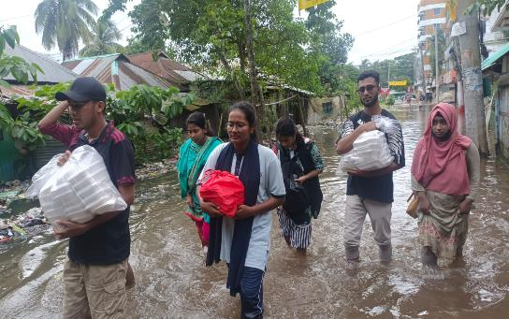
Students’ and young people’s response to the floods in Bangladesh
In September 2024, Bangladesh witnessed one of the most devastating flash floods in its history affecting the lives of more than 5.8 million people. The sudden and rapid rise in water levels during the flood left many people in Noakhali perplexed. Nevertheless, young people from all over the country took the leadership on their shoulders and launched a large-scale relief and rescue response to safeguard the lives of people who were trapped in Noakhali.
Such a testament of leadership and ownership was demonstrated by Fahida Sultana, founder and president of Service for Human Being Organization (SHBO).
ActionAid ​Bangladesh | Fahida: students and young people respond to the Noakhali floods

Slide 20
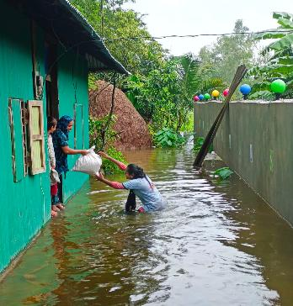
Under the leadership of Fahida, the youth-led organization began its response on 22nd August with rescue operations in the volatile areas of Shonaimuri, Bajra, Chashirhat, Joyag, Bargaon, Amishapara, and Begumganj Union of Noakhali. Fahida led a team of 70-80 volunteers who showed extreme courage by accessing the almost impregnable high tide of these areas to reach the people who were in the most vulnerable condition with little to no cellphone connection, relief, or safe shelter homes.
SHBO has helped over 3000 individuals in the 8 unions of Noakhali by providing them with their rescue operations and relief packages containing dry food, basic groceries, matches, candles, water purifiers, etc. under her bold leadership.
ActionAid ​Bangladesh | Fahida: students and young people respond to the Noakhali floods

Slide 21
What can you do?
Raise awareness: talk, post, speak out.
Reduce fossil fuel use: cycle, save energy, eat less meat.
Join school campaigns or youth groups.
Activity: Group brainstorm – “What action can your school take this year?”

Slide 22
Class discussion
Who is most responsible for fossil fuel emissions around the world? Why?
Why do some countries suffer more from the climate crisis, even though they’ve contributed less to it?
Do you think young people have a role in fighting fossil fuel use and climate change? How?
What challenges do people in poorer or rural areas face when it comes to climate impacts?
What kind of changes can individuals make in daily life to reduce fossil fuel reliance?
What responsibility do wealthy countries have in helping poorer countries respond to the climate crisis?
Do you think climate action can be fair for everyone? What would that look like?
What role should schools, communities, or governments play in building a fossil fuel-free future?
What’s one thing you’ve learned today that you could share with someone else to raise awareness about fossil fuels and climate justice?

Slide 23
Reflection: Some questions to ask
What had you heard about Campaigning for a fossil fuel free future and for climate action before and where? (from media, friends and family, just around)
Who has the power and control regarding fossil fuels’ impact? Who loses and who benefits?
Whose perspectives do you usually hear from regarding fossil fuels’ impact?

Slide 24
Actions to take
Talk about the impact of fossil fuels with your friends and family
Discuss as a class ways that you can work together with your community to take action
Write to your local politician or local newspaper outlining the changes that you would like to see

Slide 25
Actions to take
Take part in ActionAid’s ActionTalks speech writing competition, writing a speech on the topic (see below):
What does a fair, fossil fuel-free future look like and what actions can we take to get there?
First prize is a €500 voucher – learn more at www.actionaid.ie

Slide 26
Further resources
https://www.wwf.org.uk/sites/default/files/2021-11/WWF_ClimateChangeResourcePack.pdf
https://www.sciencejournalforkids.org/articles/lesson-ideas/teaching-energy-climate-change/
https://www.actionaid.org.uk/our-work/emergencies-disasters-humanitarian-response/climate-change-and-poverty#footnote3_BbWSui4DWvJBoABIVbq29Gb3b5jXxdGtcguL3uxeSM8_zYFwm0rll93m

