Slide 1

The impacts of climate change on women’s rights

Slide 2
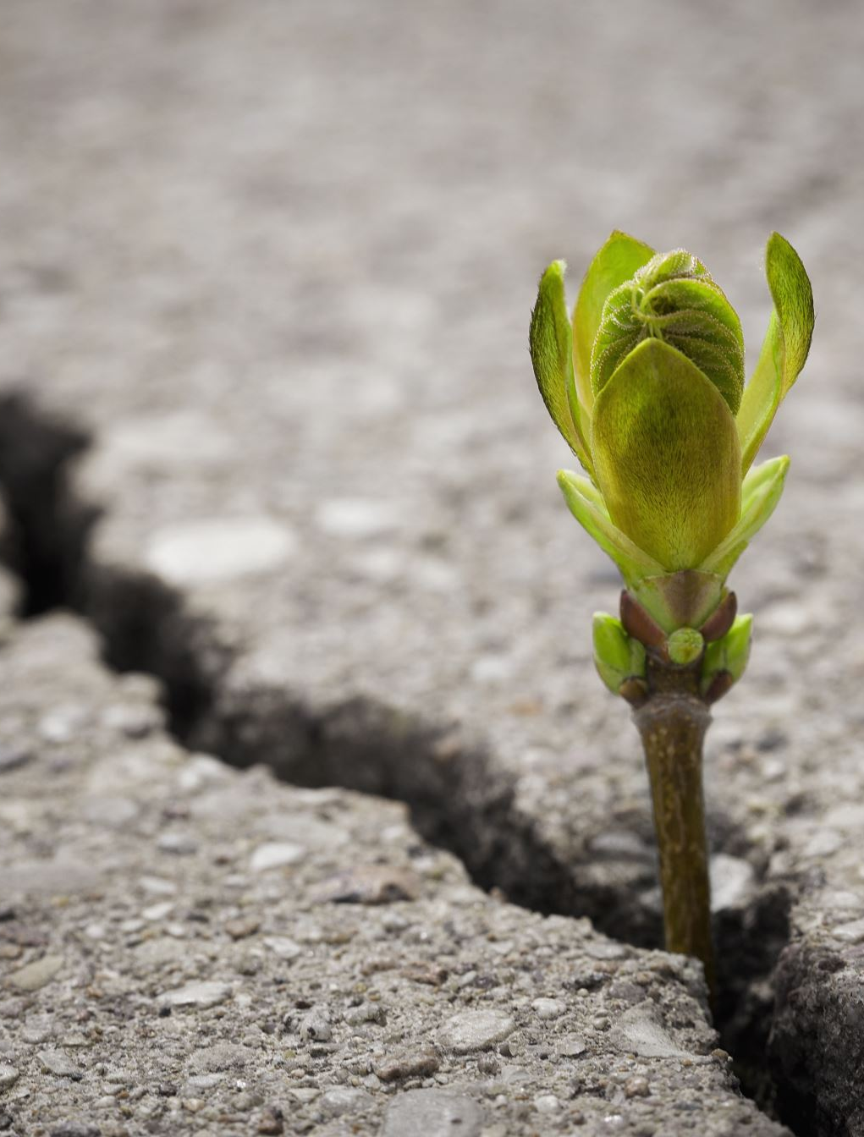
Climate change
Climate change is long-term change in the average weather and temperature patterns that have come to define Earth’s local, regional and global climates.
Starting from the 1800s, human activities have been the main driver of climate change, primarily due to the burning of fossil fuels like coal, oil and gas.
The consequences of climate change include intense droughts, water scarcity, severe fires, rising sea levels, flooding, melting polar ice, catastrophic storms and declining biodiversity.
More information here

Slide 3
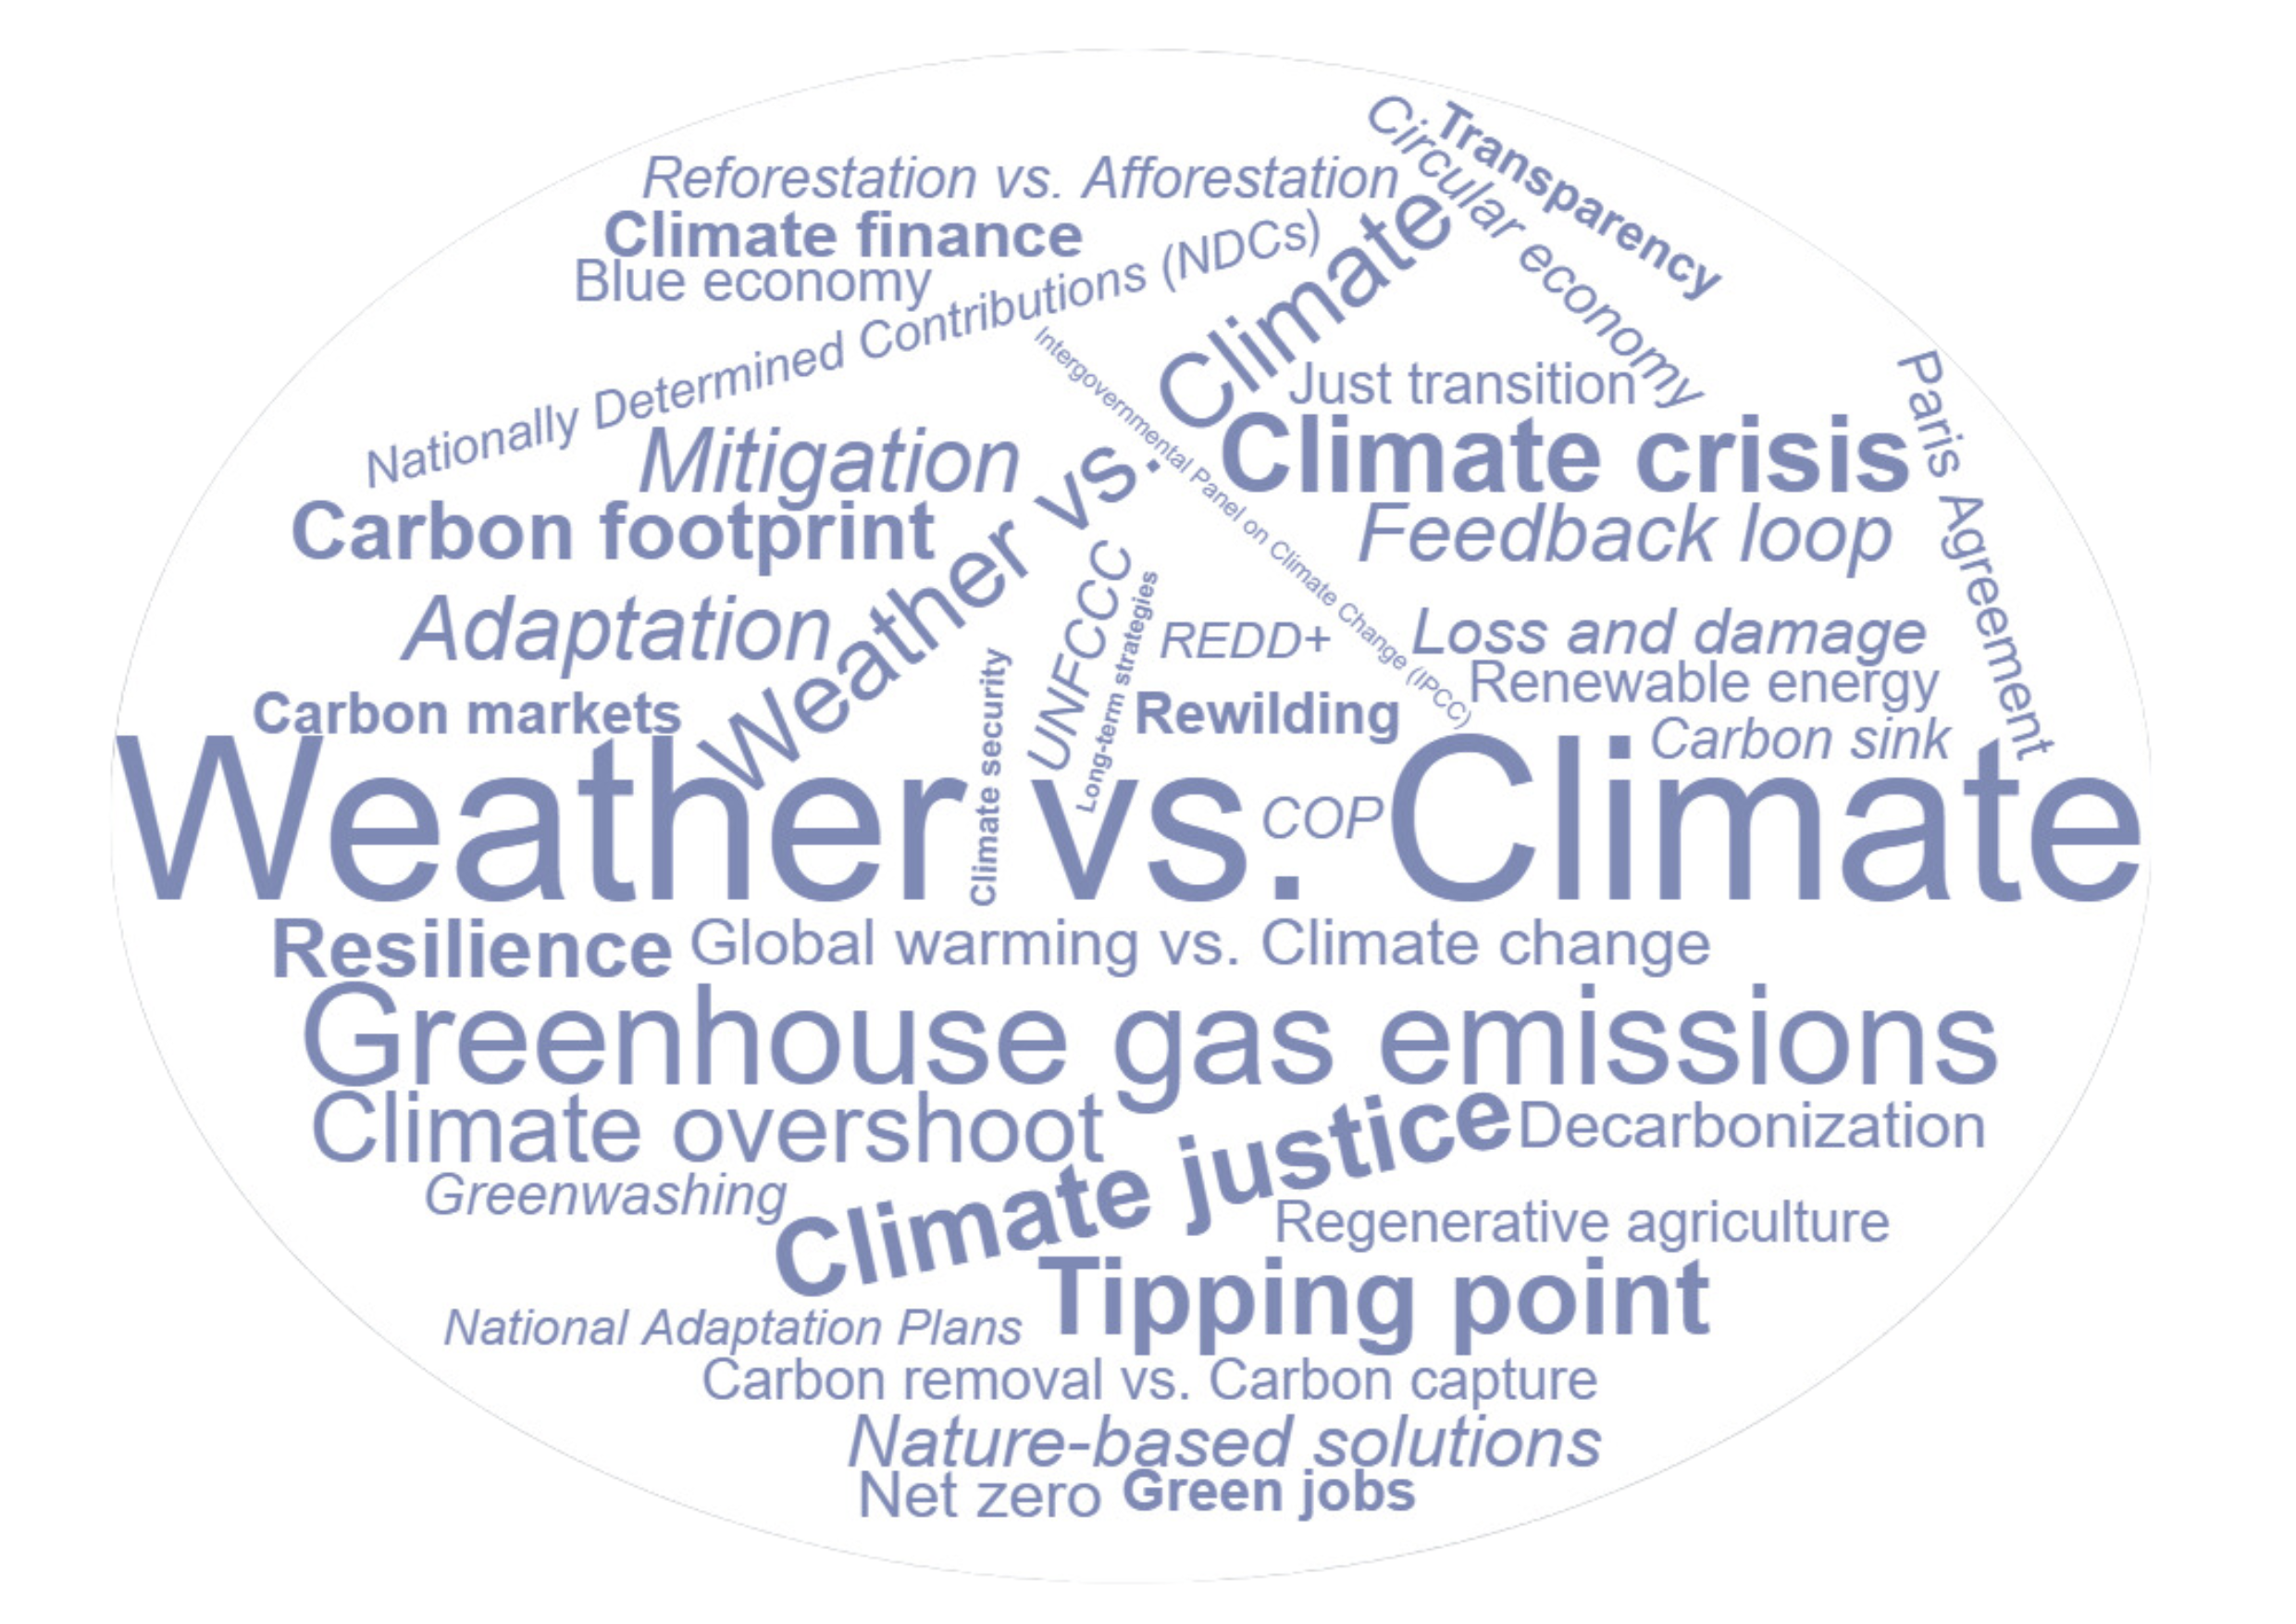
Climate change- a dictionary
Discover the climate dictionary here

Slide 4
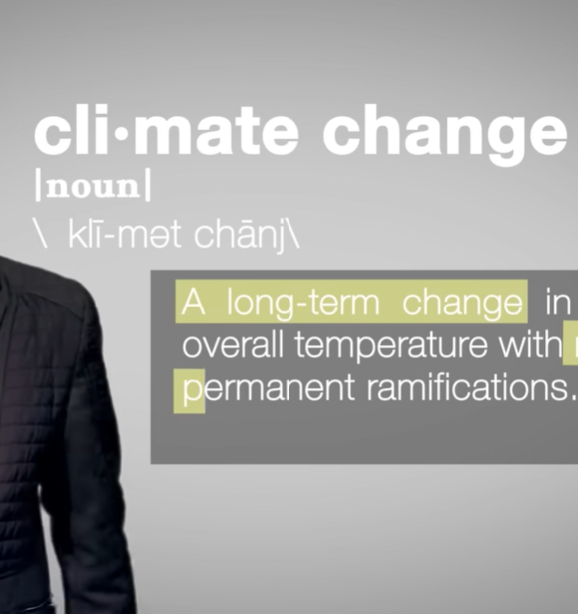
Climate change
- video
Watch here

Slide 5
True or false
It is too late to avert a climate catastrophe, so we might as well keep burning fossil fuels.
False. While the situation is dire, there is still a narrow window for humanity to avoid the worst of climate change. UNEP’s latest Emissions Gap Report found that cutting greenhouse gas emissions by 42 per cent by 2030, the world could limit global temperature rise to 1.5°C compared with pre-industrial levels.
Source: https://www.unep.org/news-and-stories/story/debunking-eight-common-myths-about-climate-change#:~:text=Myth%20%234%3A%20An%20increase%20in,weather%20conditions%20in%20a%20region.

Slide 6
True or false
Climate change affects everyone in the same way.
False. Even within the same country, the impacts of climate change may be felt unevenly due to structural inequalities based on race, ethnicity, gender, and socioeconomic status.
Example 1: In 2022, 19.1% of Ireland’s greenhouse gas emissions came from transportation. Reducing car use is crucial, but rural communities may be hit hardest since they depend on cars due to poor public transport. This can lead to "transport poverty," limiting access to social activities. Expanding public transport in these areas is essential to ensure everyone benefits fairly from climate actions.
Example 2: Women and children are 14 times more likely to die from climate disasters as men.
Sources: https://climatepromise.undp.org/news-and-stories/climate-change-matter-justice-heres-why
Example 1: https://www.nwci.ie/images/uploads/NWC_CWI_FeministClimateJusticeReport_Web_%28compressed%29.pdf Example 2: https://careclimatechange.org/evicted-by-climate-change/

Slide 7
Climate change- test your knowledge
Footprint calculator
How much do you know about the basics of climate change?
Test your knowledge on climate change

Slide 8
Climate change and women’s rights
Women and girls experience the greatest impacts of climate change:
Agriculture is the most important employment sector for women in low- and lower-middle income countries, during periods of drought and erratic rainfall, women work harder to secure income and resources for their families. This puts added pressure on girls, who often must leave school to help their mothers manage the increased burden.
As climate change drives conflict across the world, women and girls face increased vulnerabilities to all forms of gender-based violence.
When disasters strike, women are less likely to survive and more likely to be injured due to long standing gender inequalities that have created disparities in information, mobility, decision-making, and access to resources and training.
Women’s and girls’ health is endangered by climate change and disasters by limiting access to services and health care and increasing risks related to maternal and child health.
Source: https://www.unwomen.org/en/news-stories/explainer/2022/02/explainer-how-gender-inequality-and-climate-change-are-interconnected

Slide 9
Climate change and women’s rights –
EXAMPLES
From a United Nations Population Fund (UNFPA) research, results shows that the countries most at risk of climate change are also those where women and girls are in greatest danger. Of the 10 countries most vulnerable to climate change:
6 also have the highest maternal death rates in the world
5 have the highest adolescent birth rates.
7 have the worst child marriage rates.
4 have the highest rates of intimate partner violence.
Of the 14 countries most vulnerable to climate change 13 are experiencing a humanitarian crisis requiring assistance at the beginning of 2024.
source:The global climate crisis is putting women and girls in extreme danger, UNFPA warns in new data

Slide 10
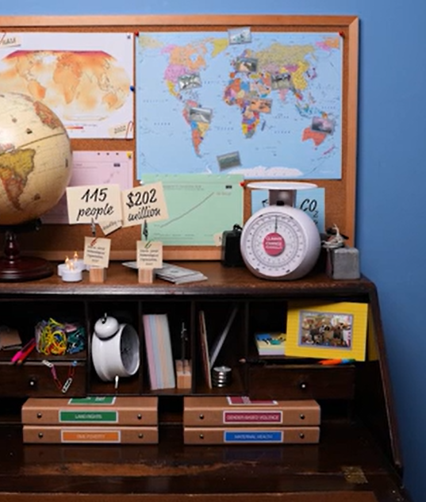
Four reasons why women are more impacted by climate change
Watch here

Slide 11
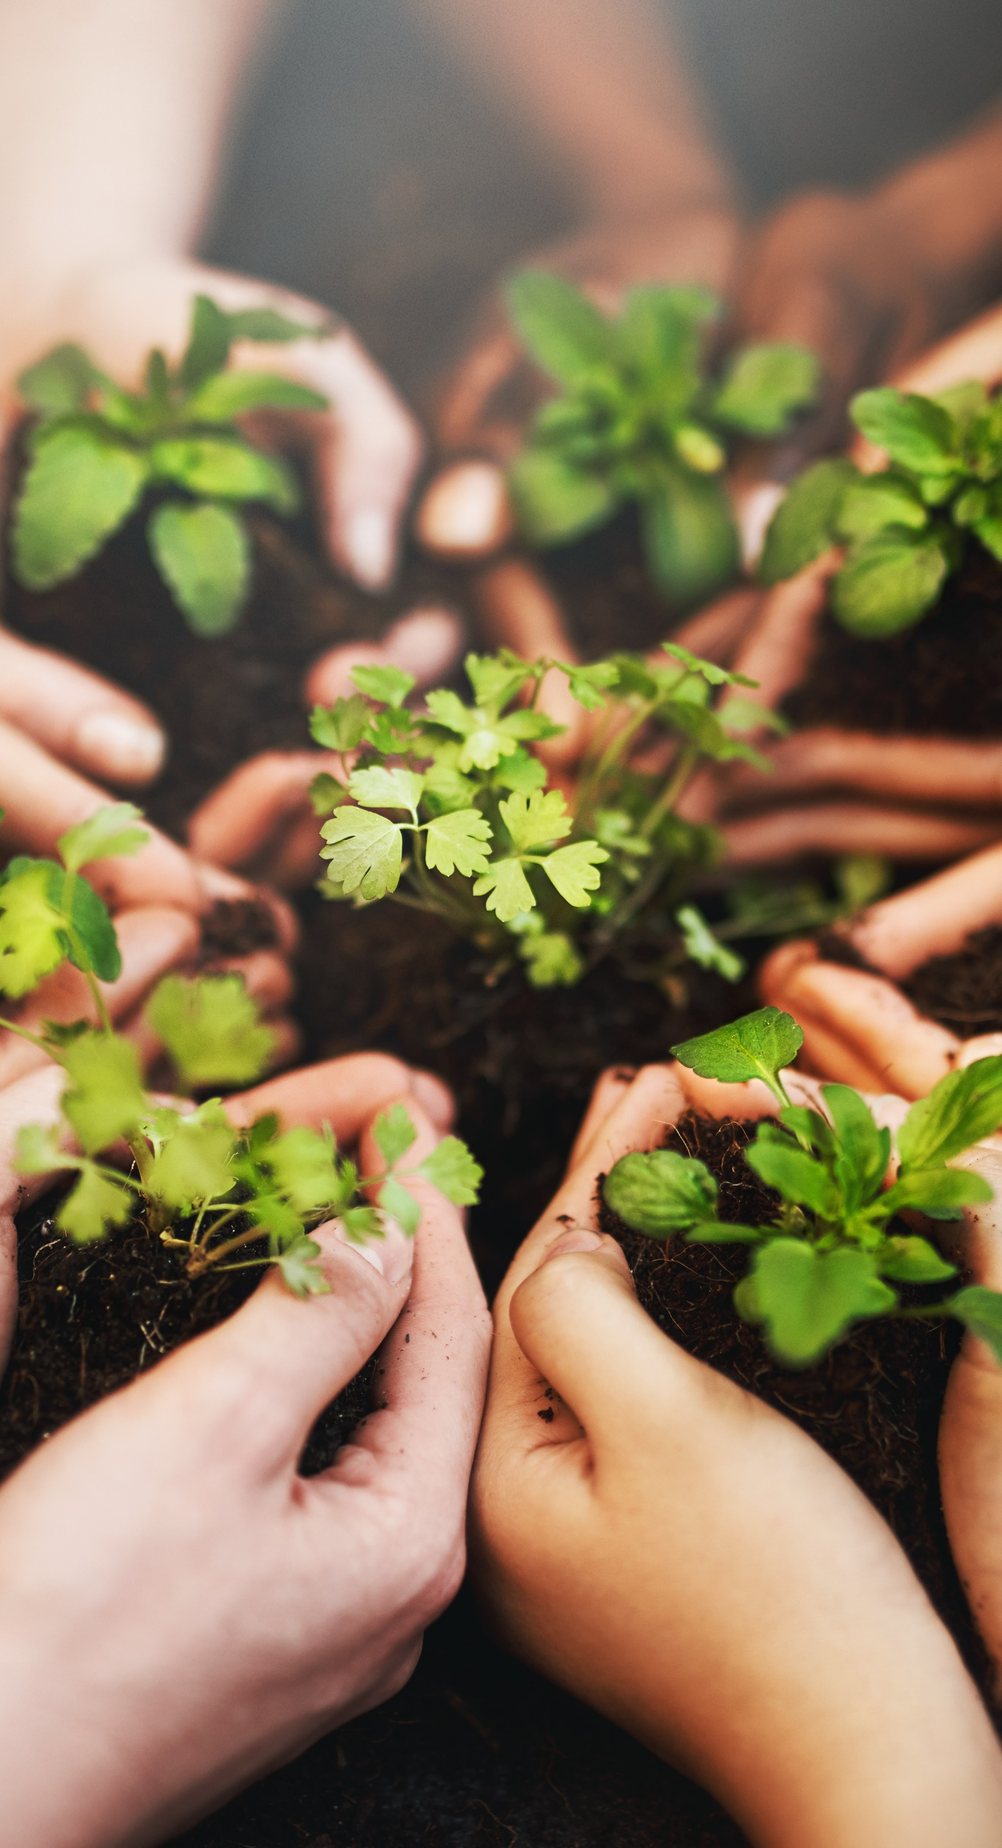
Why climate action needs women
Women are crucial in building climate resilience in communities. They are usually first responders in community responses to natural disasters, leaders in disaster risk-reduction, and contribute to post recovery by addressing the early recovery needs of their families and communities.
Women often face higher risks and greater burdens from the impacts of climate change in situations of poverty and due to existing roles, responsibilities and cultural norms.
Investing in gender equality and women's empowerment has far-reaching benefits, including environmental conservation and poverty reduction.
Source: https://unfccc.int/news/five-reasons-why-climate-action-needs-women#:~:text=The%20Gender%20Action%20Plan%20agreed,making%20and%20in%20climate%20action
More information here

Slide 12
Why climate action needs women – video
Women are key in responding to climate change because of their local knowledge and leadership in creating sustainable solutions in homes and communities.
When women are involved in politics, they address peoples' needs better, often bridging divides and helping create lasting peace. At the local level, when women lead, climate-related projects and policies are more successful.
Watch here

Slide 13
Why climate action needs women –
EXAMPLES
Mary Robinson
Tinebeb Berhane
Mary Robinson, Ireland's first female President (1990-1997), is a renowned advocate for human rights, democracy, gender equality and climate justice. As UN High Commissioner for Human Rights (1997-2002), she gained recognition for her work investigating and exposing global human rights abuses across the world.
A strong voice for climate justice, Robinson served as the UN Secretary General's Special Envoy from 2013 to 2016, addressing issues in Africa’s Great Lakes region, climate change, and the impacts of extreme weather on vulnerable communities. She continued in this post until the end of December 2015 which saw the successful conclusion of the COP21 Climate Summit and the historic Paris Agreement on Climate Change.
Tinebeb Berhane is a professional woman with demonstrated passion for development and fighting injustice and experience in supporting women, girls, young people and vulnerable groups to fight for their rights and play a leadership role in their own development. She has strategically supported civil society in Ethiopia to challenge shrinking civic space.
As Program and Country Director for ActionAid Ethiopia, she was part of a national Climate Justice Campaign, and her work focuses in calling up on the global polluting powers to pay attention to the rapidly deteriorating climate that is devastating the lives of world population.

Slide 14
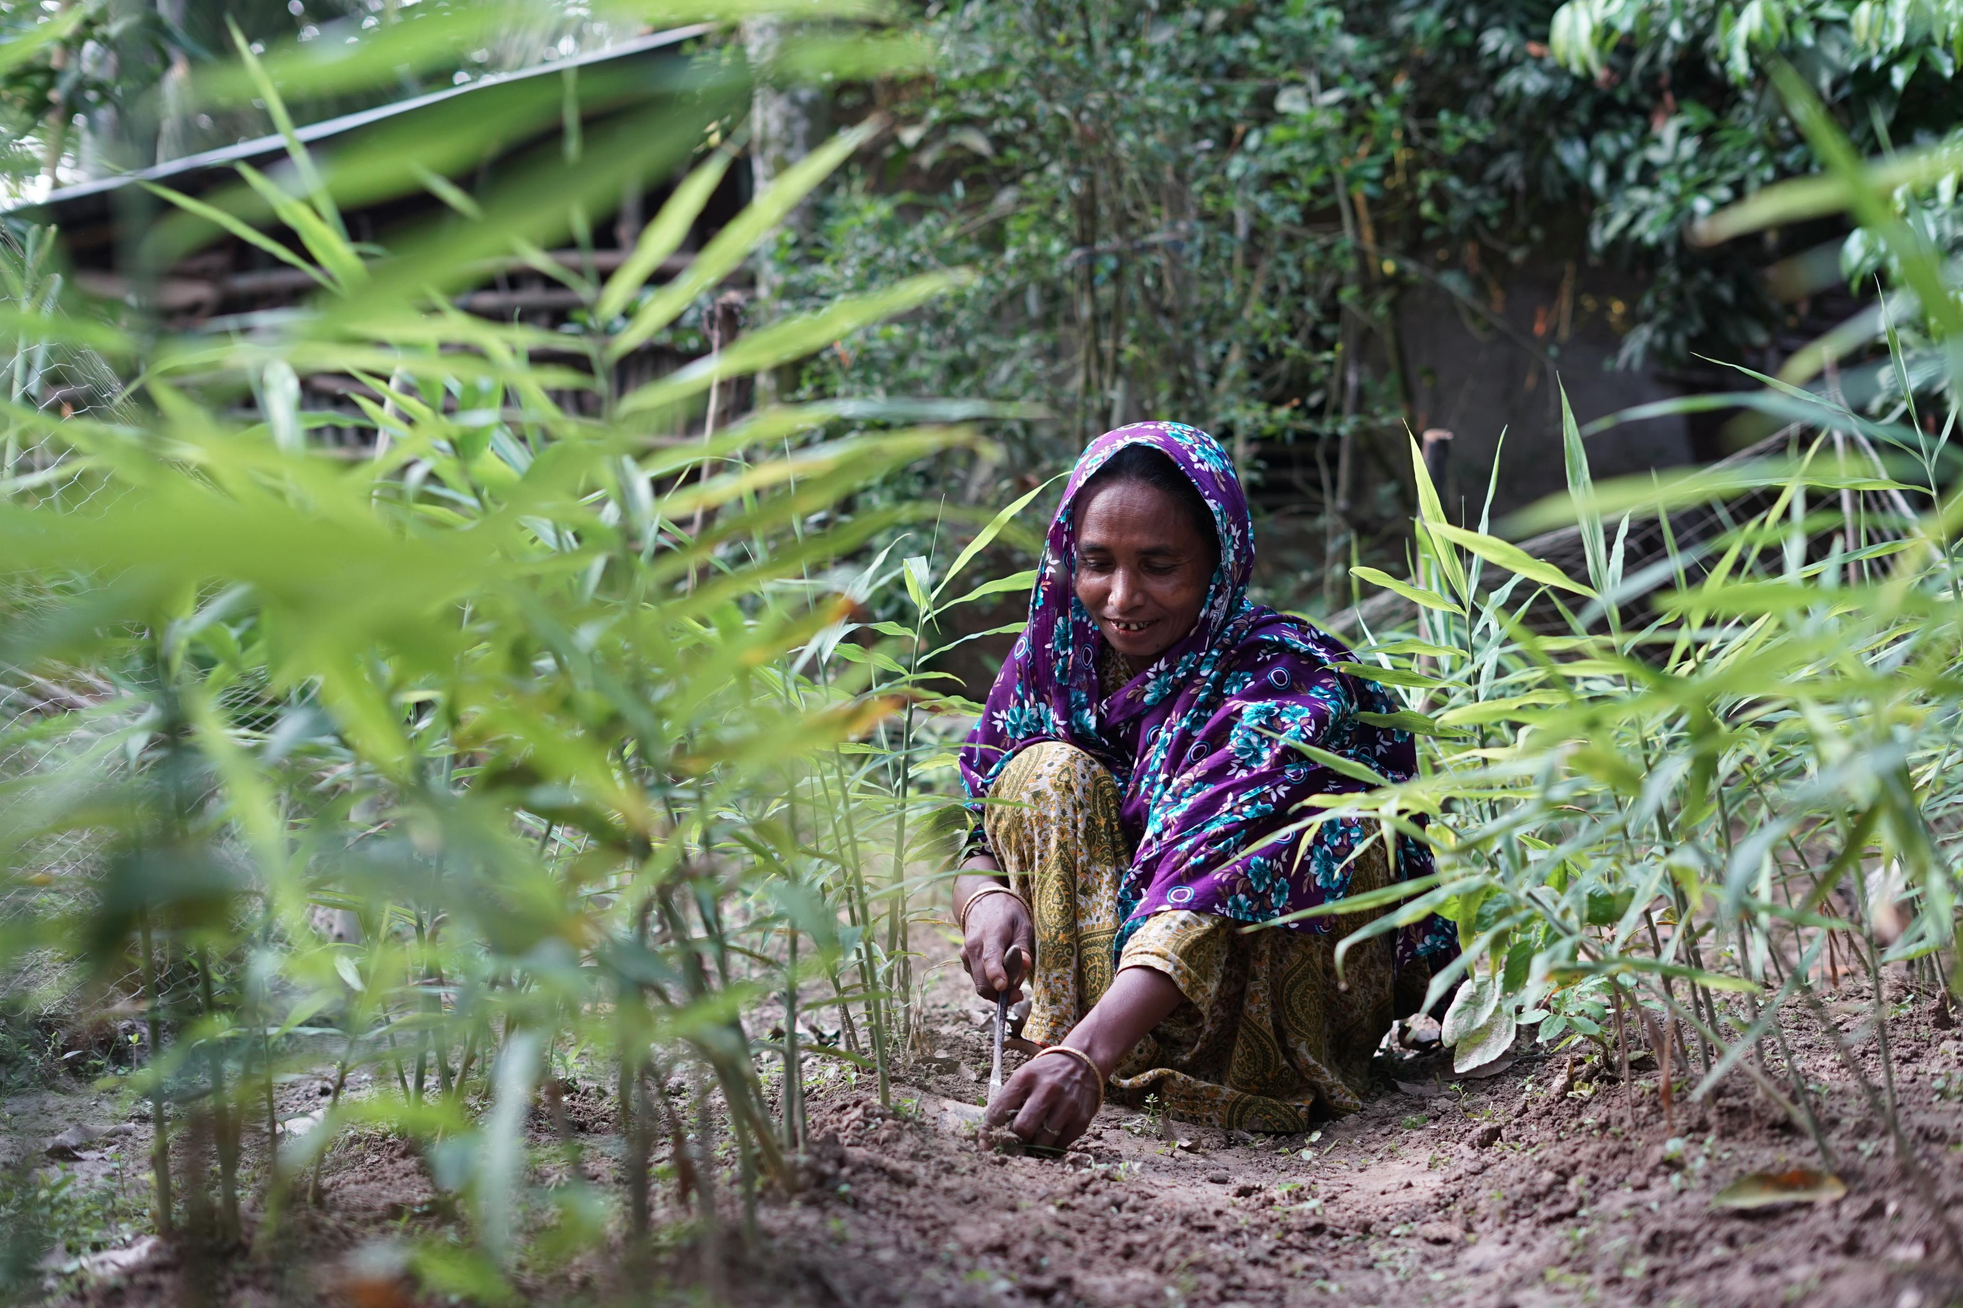
Case study
Despite their central role in agriculture, women farmers in Bangladesh face marginalization. To address their challenges ActionAid Bangladesh has completed a project ‘Women-led Solutions to Food Insecurity and Livelihood in the Face of Climate Change’ .
For years, crops on Gulshan Ara’s farm were destroyed by floods and drought. But today, Gulshan is a winner of two prestigious awards and is building a better future for her family, and her community.
“Now when I look back to the days when two meals were a luxury, the reality of today seems like a dream. We can have fish, meat and eggs any day we want. I never thought we would see a day like today.”
Gulshan enrolled her grandchild in an ActionAid Bangladesh programme, Child Space. From there she enrolled in the ActionAid climate change agriculture project where she learnt about cultivating diversified plants and vegetables. This allowed her grow enough to meet the food needs of her family, and with a surplus she was able to save money and buy an extra plot of land.
More stories here.
ActionAid Bangladesh | Gulshan Ara, small farmer in Bangladesh

Slide 15
Class discussion
Do you think women have a role in finding a solution to the climate crisis?
How can they help?
What are the challenges of climate change for women’s rights?
What do consumers need to do to support women’s rights and cut down on emissions?
What kind of actions can we take to combat climate change?
Do you think we can combat the impact of climate change in a way that is respectful of women’s rights?

Slide 16
Reflection: Some questions to ask
What had you heard about climate change’s impact on women’s rights before and where? (from media, friends and family, just around)
Who has the power and control regarding climate change’s impact on women’s rights? Who loses and who benefits?
Whose perspectives do you usually hear from regarding climate change’s impact on women’s rights?

Slide 17
Actions to take
Talk about the impact of climate change on women’s rights with your friends and family
Discuss as a class ways that you can work together with your community to take action
Write to your local politician or local newspaper outlining the changes that you would like to see

Slide 18
Actions to take
Take part in ActionAid’s ActionTalks speech writing competition, writing a speech on the topic (see below):
The climate crisis is causing devastation across the globe, affecting in particular countries in the Global South and particularly for women, driven by our dependence on fossil fuels. Unless the world urgently ends our reliance on fossil fuels, women’s rights will be denied and violated due to the impacts of climate change. Discuss.
First prize is a €500 voucher – learn more at www.actionaid.ie

Slide 19
Further resources
https://www.actionaid.org.uk/our-work/emergencies-disasters-humanitarian-response/climate-change-and-gender
https://www.undp.org/blog/women-are-hit-hardest-disasters-so-why-are-responses-too-often-gender-blind
https://youtu.be/CCcmS-foy3Q?si=3FPolcgNGnhvWYnV
https://www.ohchr.org/sites/default/files/Documents/Issues/ClimateChange/materials/KMClimateChange.pdf
Ideas for activities: https://adulteducationcityofdublinetb.ie/wp-content/uploads/2023/06/138530-CDETB-Climate-Justice-book-WEB-Version.pdf
https://www.youth.ie/programmes/projects-initiatives/climate-justice/
https://environmentalsolutions.mit.edu/wp-content/uploads/2023/10/A-Starter-Guide-for-Teaching-Climate-Environmental-Justice.pdf
https://youtu.be/luO8phhdfsA
https://youtu.be/2njn71TqkjA?feature=shared
https://youtu.be/XIiSZ1hFLlc

