Slide 1

Education: women’s rights and the fight for equality

Slide 2
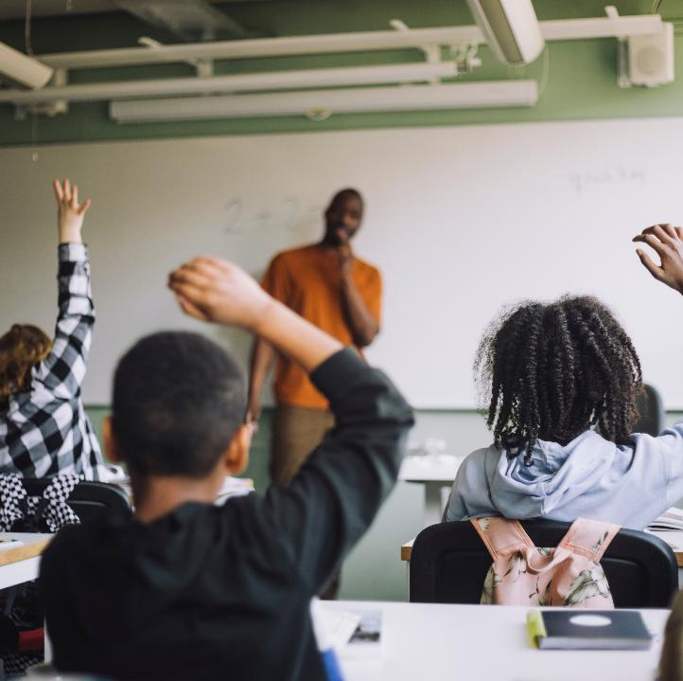
“Everyone has the right to education.”
Article 26 of the 1948 Universal Declaration of Human Rights
Ensuring inclusive, equitable, and quality education and the promotion of lifelong learning opportunities for all
Sustainable Development Goal 4

Slide 3
The importance of education
Education is the basic building block of society and the best investment for building prosperous, healthy, and equitable communities.
Despite this, 57 million children are still out of school.
Education is both a right and a passport to human development, expanding opportunities and freedoms. Sustainable Development Goal 4: Ensuring Inclusive, Equitable, and Quality Education and the Promotion of Lifelong Learning Opportunities for All, aims to ensure inclusive, equitable, and quality education and promote lifelong learning by addressing barriers through targets such as increasing scholarships in developing nations and creating gender-sensitive and disability-inclusive educational facilities.

Slide 4
Why access to education and services matters, especially for girls and women
Sustainable and shared economic development increasingly relies on governments' ability to implement policies for marginalized groups and remove barriers to learning and labor market access.
Despite progress over the past decade, women and girls still face the greatest challenges in accessing education and training, requiring urgent policy action.
Early school leavers are at risk of unemployment, poverty, early marriage, and pregnancy. Contributing factors include poverty, gender, disability, family crises, conflict, and low perceived value of education.
Alternative learning opportunities that address these issues are essential to help youth build basic knowledge and skills for employment, entrepreneurship, or other productive work.
Read more:
https://www.un.org/sustainabledevelopment/education/
https://www.un.org/en/academic-impact/education-all

Slide 5
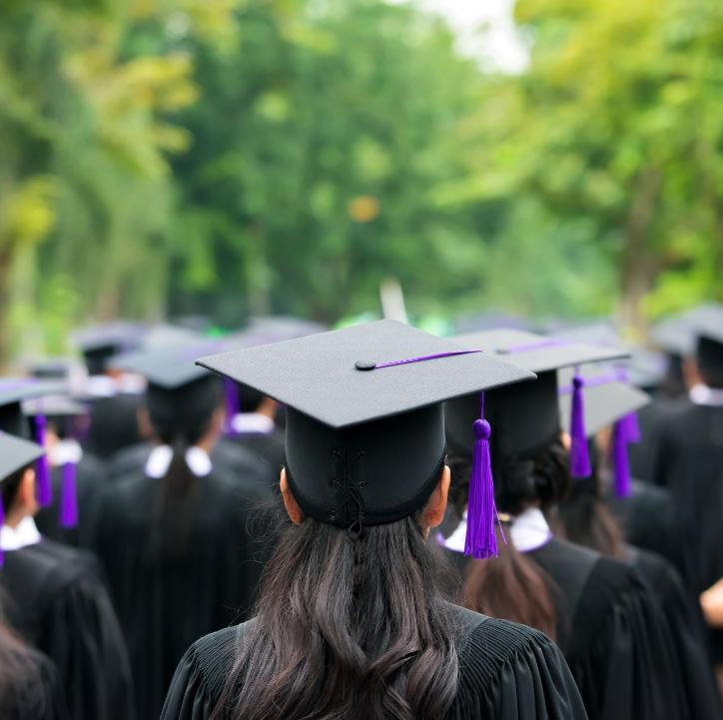
Gender inequality in education
- video
Watch here

Slide 6
True or false
Worldwide, 2% of countries still do not guarantee the right to education in their Constitution or laws.
False. Worldwide, 16% of countries still do not guarantee the right to education in their Constitution or laws.
Source: https://www.unesco.org/en/articles/key-data-girls-and-womens-right-education

Slide 7
True or false
At the global level, 5% of countries do not guarantee neither compulsory nor free primary and secondary education
True
Source: https://www.unesco.org/en/articles/key-data-girls-and-womens-right-education

Slide 8
True or false
According to UNICEF estimates, around the world, 12 million girls are out of school
False. According to UNICEF estimates, around the world, 122 million girls are out of school
Source: https://www.worldbank.org/en/topic/girlseducation

Slide 9
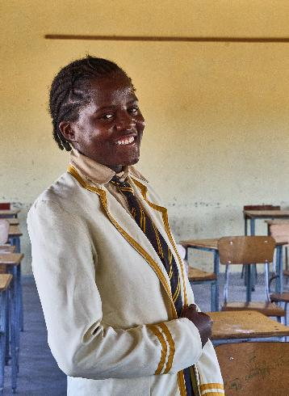
Case study
Pearl, 16, is head girl at her school in rural Zimbabwe, where chronic underfunding and climate shocks are threatening girls’ futures. Despite dreaming of becoming a pharmacist, Pearl had to drop Shona, Zimbabwe’s main language, as an exam subject due to a lack of textbooks, where there were just two for the entire Form 4 class.
With broken furniture forcing students to learn outdoors and fees going unpaid due to poverty and hunger, many girls are losing access to quality education. Long walks to school leave them vulnerable to exploitation, with “sugar daddies” offering food in exchange for sex.
“The biggest challenge that most girls encounter is having to travel long distances from their homes to school; most of them travel from afar. That’s what makes them vulnerable to “sugar daddies,” and then they get lured with such things as corn or potato snacks. Most of the time girls are the ones who come late to school unlike boys -even if they [the girls] are admonished they do not take heed; they give all sorts of excuses. They come at whatever time and they don’t care.”
Pearl’s story highlights how underfunded public services, worsened by the climate crisis and an unjust global financial system, are pushing girls out of school and into danger. Her experience shows why Financing for Development must deliver urgent action to invest in education and dismantle economic rules that trap Global South countries in debt and austerity, denying girls like Pearl the chance to fulfil their potential.
@Tendai ​Marima/​ActionAid
Pearl, 16, is head girl at her school in rural Zimbabwe, where chronic underfunding and climate shocks are threatening girls’ futures

Slide 10
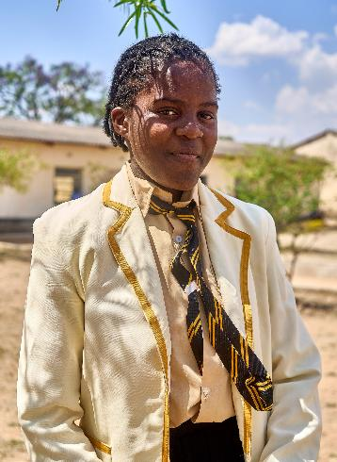
“Right now what’s lacking [at the school] are textbooks especially Shona textbooks. English textbooks are there through a donation that was made by some who donated the books. Shona textbooks are the ones that are a problem -right now among the Form 4s we only have two. When it’s time for Shona lessons, they bring the two textbooks to one class and they are shared between the boys and the girls; the rest of the class has to follow one pupil who will be reading to the rest of the class -this will be for comprehension exercises. As for me, to tell the truth, that’s why I did not register to write the Shona exam. If someone reads, I don’t quite understand and I want to read for myself. I would resort to copying what others would have written but still I would not understand and I decided to drop Shona. That’s one problem.”
“The other problem is furniture -we don’t have school furniture. For instance, when the Form 4s started writing we were told to go and get chairs from the Form 3 classes and it was brought here. And for agriculture the chairs that were there were taken to Form 3 classes and pupils no longer have lessons in class but outside while sitting on stones, of which the lessons should be in a classroom but they can’t use one because there is no furniture.”
“As for money, as far as I know there is also not enough money for the school -they want to buy a school bus, but many pupils do not pay school fees, and when they are sent back home for non-payment of the school fees they linger in the playgrounds.”
@Tendai ​Marima/​ActionAid
Pearl, 16, is head girl at her school in rural Zimbabwe, where chronic underfunding and climate shocks are threatening girls’ futures

Slide 11
Activity
Discuss together
What would you miss most if you couldn’t go to school?

Slide 12
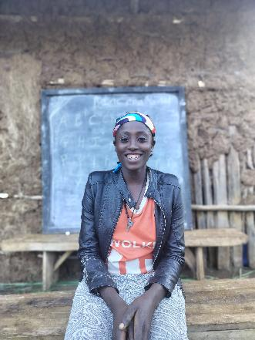
Case study:
Demekich Ticigre, a young woman from from Shey Bench, Ethiopia, experienced a profound personal transformation through a literacy class supported by ActionAid Ethiopia and funded by Irish Aid. "Before I took part in the training, I was unfamiliar with the bench language (the local language). Now, I can differentiate sounds and spellings because of the training. I have managed to change my perceptions, and I can write my own name."
Not being able to read or write affected Demekich’s opportunities and independence. Like many women in her community, she had no access to higher education and struggled to navigate everyday tasks that required reading and writing. The distance to schools and cultural barriers had kept her from learning basic literacy skills.
Now, as the secretary of her local savings cooperation she expresses newfound confidence: " I am the one who writes the monthly savings logs of contributions by the women and even when I go to the market there are different writings and now I am able to know what each shop sells and I know which shop to go to buy the things I need.” “My dream is to move back to the city to ensure that I can get a proper education on top of what I have got now and get a related job. I can go to Mizan or Wacha for better opportunities”
@ActionAid Ireland
The literacy classes not only taught her to read and write but also covered critical topics like gender equality, health, disease prevention, and agriculture. Her ability to write meeting minutes, read savings logs, and understand market signage has dramatically changed her daily life.

Slide 13
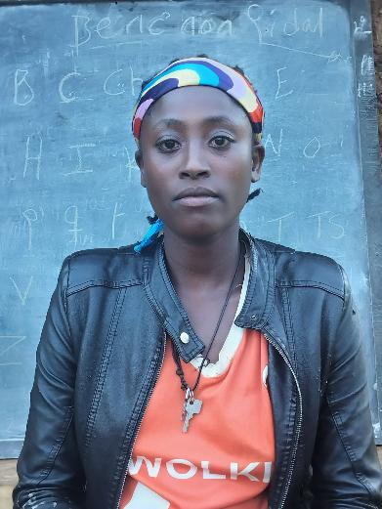
ActionAid's contribution
Through the Women's Rights Programme, funded by Irish Aid, the government’s programme for overseas development, ActionAid Ethiopia has made significant strides in adult literacy and empowerment. Their response has included:
Providing literacy classes in the remote areas of Semen Bench and Shey Bench
Addressing gender issues and providing holistic education
Supporting women's economic participation
Empowering women to break cycles of poverty
Collaborating with local women, children, and youth offices
Read more about the Women’s Rights Programme here.
@ActionAid Ireland

Slide 14
Class discussion
Why is education especially important for girls and women?
What did you learn today that challenged your previous assumptions?
How are issues of gender inequality in education connected to wider social and economic problems?
How can access to education change someone’s life?
What are some practical ways communities and governments can support girls' education?
What role can young people play in promoting education and equality for all?
What is one action you can take or advocate for to support girls’ education and rights?

Slide 15
Reflection: Some questions to ask
What had you heard about the importance of access to education before and where had you heard about it? (from media, friends and family, just around)
Who has the power and control when it comes to access to education? Who loses and who benefits?
Whose perspectives do you usually hear when it comes to access to education?

Slide 16
Actions to take
Talk about access to education with your friends and family
Discuss as a class ways that you can work together with your community to take action
Write to your local politician or local newspaper outlining the changes that you would like to see

Slide 17
Actions to take
Take part in ActionAid’s ActionTalks speech writing competition, writing a speech on the topic (see below):
Imagine a world where every girl wakes up knowing she has the same chance to succeed as her brother. A world where education is not a privilege, but a right for everyone. Yet today, millions of girls are still denied that chance. They are held back by poverty, conflict, discrimination, and outdated beliefs. If we want a fairer, stronger, and more equal world, we must start with education. And we must start with girls. Discuss.
First prize is a €500 voucher – learn more at www.actionaid.ie

Slide 18
Further resources
https://www.into.ie/app/uploads/2024/06/202409_INTO-Submission_StrategyWomenGirls.pdf
https://www.unesco.org/en/heratlas
https://www.right-to-education.org/girlswomen
https://malala.org/girls-education
https://actionaid.org/news/2025/crippling-budget-cuts-leave-africas-public-sector-workers-underpaid-overworked-and

