Slide 1

Women's rights organisations as the key to ending violence against women and girls

Slide 2
What is violence against women and girls?
Violence against women and girls can be defined as any form of violence that results in, or is likely to result in, physical, sexual, or mental harm or suffering to women, including threats of such acts, coercion or arbitrary deprivation of liberty, whether occurring in public or in private life.
Violence against women and girls is one of the world’s most prevalent human rights violations, taking place every day, many times over, in every corner of the globe. It has serious short- and long-term physical, economic and psychological consequences on women and girls, preventing their full and equal participation in society.
Violence against women and girls is is a major obstacle to the fulfilment of women’s and girls’ human rights and to the achievement of the 2030 Agenda for Sustainable Development. It occurs worldwide, cutting across all generations, nationalities, communities and spheres of our societies, irrespective of age, ethnicity, disability or other background.
Sources: https://www.unwomen.org/en/articles/faqs/faqs-types-of-violence-against-women-and-girls
https://www.who.int/news-room/fact-sheets/detail/violence-against-women
https://www.un.org/sustainabledevelopment/ending-violence-against-women-and-girls/

Slide 3
True or false
Violence against women and girls (VAWG) includes sexual violence, domestic abuse, female genital mutilation, forced marriage and so-called ‘honour-based’ abuse, exploitation, harassment but it doesn’t include stalking and abuse of women and girls in online spaces.
False. Violence against women and girls (VAWG) includes all the things listed above.
Source: https://www.endviolenceagainstwomen.org.uk/explainer/

Slide 4
True or false
Globally about 1 in 3 (30%) of women worldwide have been subjected to either physical and/or sexual intimate partner violence or non-partner sexual violence in their lifetime.
True.
Source: https://www.who.int/news-room/fact-sheets/detail/violence-against-women

Slide 5
True or false
Most of the violence against women and girls is perpetrated by individuals outside of close or intimate relationships.
False. Worldwide, almost one third (27%) of women aged 15-49 years who have been in a relationship report that they have been subjected to some form of physical and/or sexual violence by their intimate partner.
Source: https://www.who.int/news-room/fact-sheets/detail/violence-against-women

Slide 6
The importance of women rights’ organisations
Fighting violence against women and girls (VAWG) is complex and challenging – but not impossible. Fearless women and women’s rights organisations have led this fight for decades, with real, tangible results.
Local women’s rights organisations are best placed to end violence in their communities. Their work is strategic, lasting, and cost-effective, transforming the lives of marginalised women and girls. Yet, they receive only around 1.5% of aid for gender equality.
Investing in women’s rights organisations empowers women to challenge violence and the gender inequality behind it. They address violence holistically—from changing social attitudes and delivering frontline services, to political action—and tackle discrimination based on class, caste, ethnicity, age, or sexual orientation.
Investing in feminist movements is the most effective way to drive policies ending VAWG. In 25 years, countries with domestic violence laws increased from 7 to 127—change driven by collective action from women’s rights organisations. They also secured the inclusion of VAWG in Sustainable Development Goal 5 and ensure laws are implemented and enforced.
Source: https://www.actionaid.org.uk/our-work/vawg/womens-rights-organisations

Slide 7
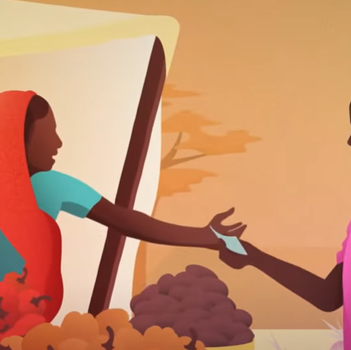
Video
Watch here

Slide 8
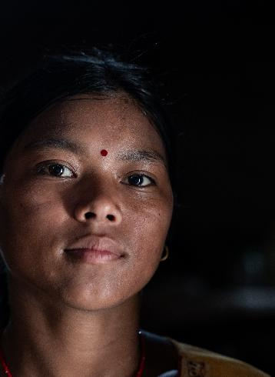
Case study
In Nepal, a quarter of the population lives on less than $1.25 a day, and recent conflict and disasters have made it especially hard for communities to lift themselves out of poverty. Nepal is highly vulnerable to climate change, with heavy rainfall and resulting floods causing the deaths of nearly 250 people, including 55 children, in late 2024.
Despite some progress, it is a country where women experience huge inequality. Just 45% of adult women can read or write, compared with 72% of men, and girls commonly drop out of school due to the demands of household chores. 36% of women and girls have never attended school - twice as many as men and boys.
Tanuja Bote, is a young woman from a family with eight siblings. she was given up at three years old for domestic labour. The household that took her in told her she had no parents and that her life was to serve them. From ages three to 13, she was beaten so badly that she lost some of her hearing. At one point, she was even put in a water tank as punishment.
By age 14, Tanuja realized she had to escape her situation. With the help of another girl in the house, she saved enough money to travel back to her parents' village. However, she quickly realised her family couldn't support her, and child marriage seemed the only survival option.
@Dangol/​ActionAid

Slide 9
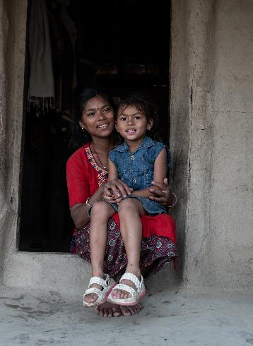
She arranged a marriage online with a man over a decade older than her. She became pregnant with a daughter while still a child herself, feeling isolated and confused about her life's trajectory.
"I felt alone and couldn't make sense of what had happened to me" Tanuja explains.
Everything changed when she encountered a women's group supported by ActionAid's partner, the Chitwan Sakriya Women's Foundation. For the first time, she found a support system that helped her understand her experiences.
"The group helped me realise the impact of child marriage and the systemic challenges I faced" she says. "I'm no longer isolated."
Now 18, Tanuja has a clear vision for the future. Her primary dream is for her daughter to have opportunities she was denied - particularly the chance to go to school and live free from exploitation.
"I want my daughter to have a childhood" she says. "I want her to have choices I never had."
@Dangol/​ActionAid

Slide 10
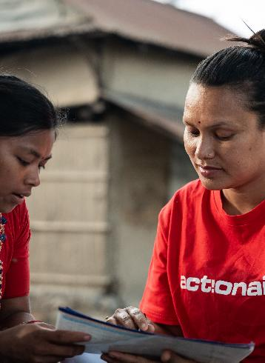
ActionAid's contribution
ActionAid's Women's Rights Programme, supported by Irish Aid, has been running since 2012. In a country with chronic levels of gender-based violence, ActionAid's partners in Nepal work with women experiencing poverty to claim their rights - particularly to reduce gender-based violence and empower women economically.
In Chitwan, domestic violence is high, along with child marriages, alcoholism and drug abuse. Patriarchal norms run deep. Women who are active and engage in community life are often treated with suspicion and accused of having affairs, just for leaving their homes to do things independently.
The women's group has provided:
A safe space for women experiencing violence
Support with referrals to police or seeking medical help
Awareness about rights and how patriarchy affects daily life
Understanding of how poverty affects their lives and what actions they can take
Alternative sources of income, such as buffalo rearing
Shifts in power dynamics within homes and the community
@Dangol/​ActionAid

Slide 11
Activity
In small groups, create a mini action plan for how a women’s rights organisation could help reduce violence against women and girls in a specific context (e.g. their school, local community, or a fictional town).
Consider the following:
What kind of violence are they addressing?
What kind of support will the organisation provide?
How will they raise awareness and change attitudes?
What services or systems might they set up?
How will they empower women and girls?
Create a visual plan (mind map or bullet points) to present back to the class.

Slide 12
Class discussion
Why do you think violence against women and girls remains such a widespread problem?
What surprised you most about the statistics or definitions of VAWG presented?
Why are local women’s rights organisations better placed to tackle violence in their communities than outside organisations?
What role do education, income, and awareness play in reducing gender-based violence?
What can we, as individuals or as a class, do to support efforts to end violence against women and girls?

Slide 13
Reflection: Some questions to ask
What had you heard about women’s rights organisations as the key to ending violence against women and girls before and where had you heard about it? (from media, friends and family, just around)
Who has the power and control when it comes to the work of women’s rights organisations and their fight to end violence against women and girls? Who loses and who benefits?
Whose perspectives do you usually hear from when it comes to this topic?

Slide 14
Actions to take
Talk about women’s rights organisations as the key to ending violence against women and girls with your friends and family
Discuss as a class ways that you can work together with your community to take action
Write to your local politician or local newspaper outlining the changes that you would like to see

Slide 15
Actions to take
Take part in ActionAid’s ActionTalks speech writing competition, writing a speech on the topic (see below):
Violence against women and girls is one of the most common and harmful human rights violations in the world. But change is possible and women’s rights organisations are leading the fight. They provide support, raise awareness, and empower women to stand up against abuse. They are changing lives but they are critically underfunded. If we want a world where women and girls are safe, equal, and free, we must support the people already working to make that world a reality. Discuss.
First prize is a €500 voucher – learn more at www.actionaid.ie

Slide 16
Further reading
https://www.actionaid.org.uk/our-work/womens-rights/violence-against-women-and-girls-vawg#footnote5_jLMIcZC1m0M0vqHn7KPlB8XdKJCOIex50tsWPwkI9c_dBm27xZ0kqqG
https://eige.europa.eu/gender-based-violence/countries/ireland?language_content_entity=en
https://womenlobby.org/our-work/ending-vawg/
https://www.endviolenceagainstwomen.org.uk/wp-content/uploads/EVAW-Coalition-Schools-Guide.pdf
https://www.ohchr.org/en/women/gender-based-violence-against-women-and-girls

